Slide 1

Using NCS in Korean VET Systems
Dr. Bae, Chang-Ok
국가직무능력표준

Slide 2


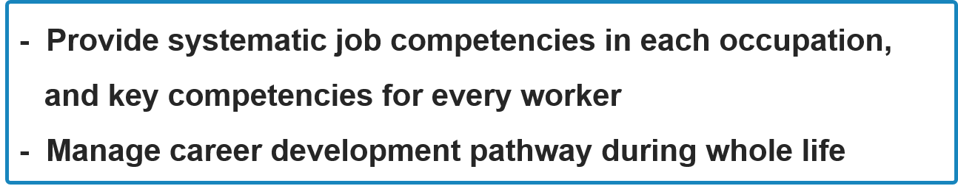
Backgrounds

Slide 3
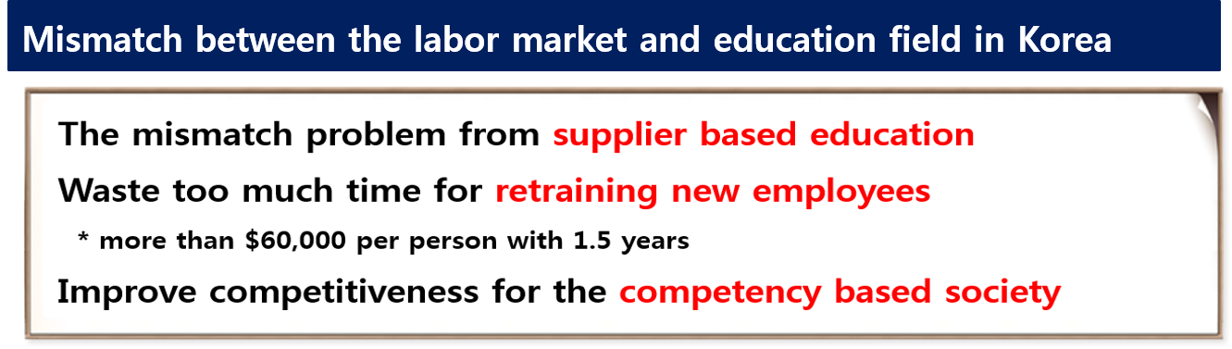
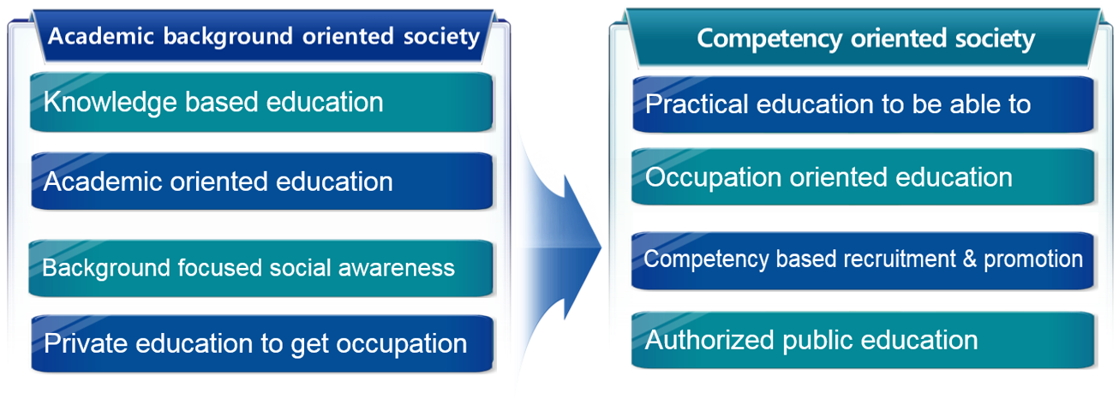
Backgrounds

Slide 4
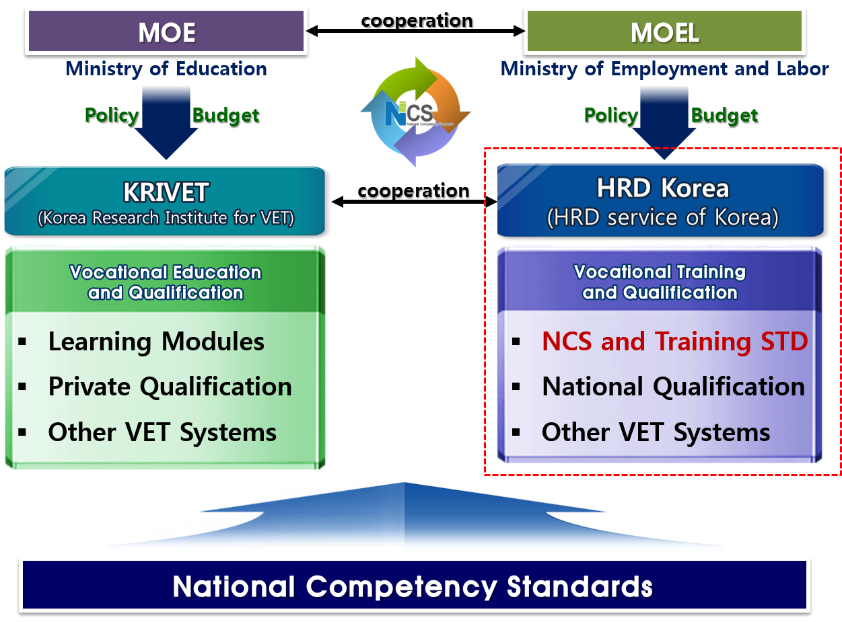
Backgrounds

Slide 5
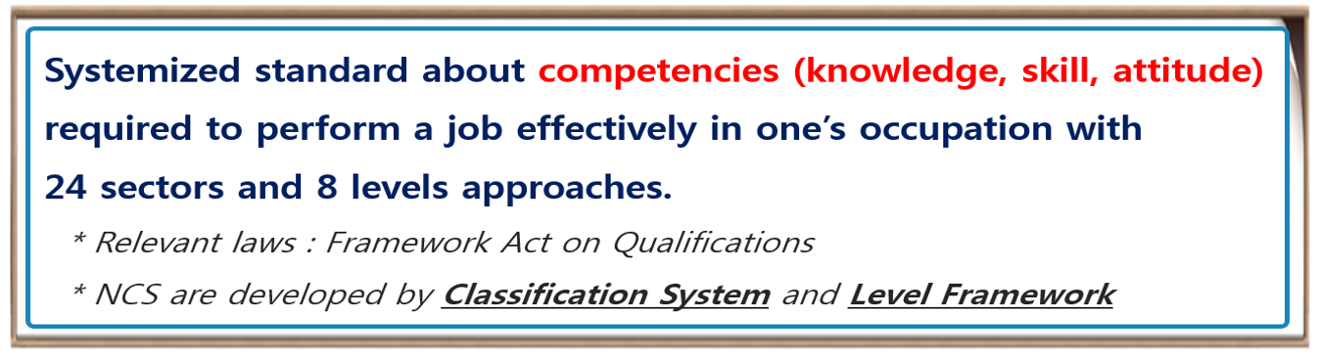

National Competency Standards

Slide 6

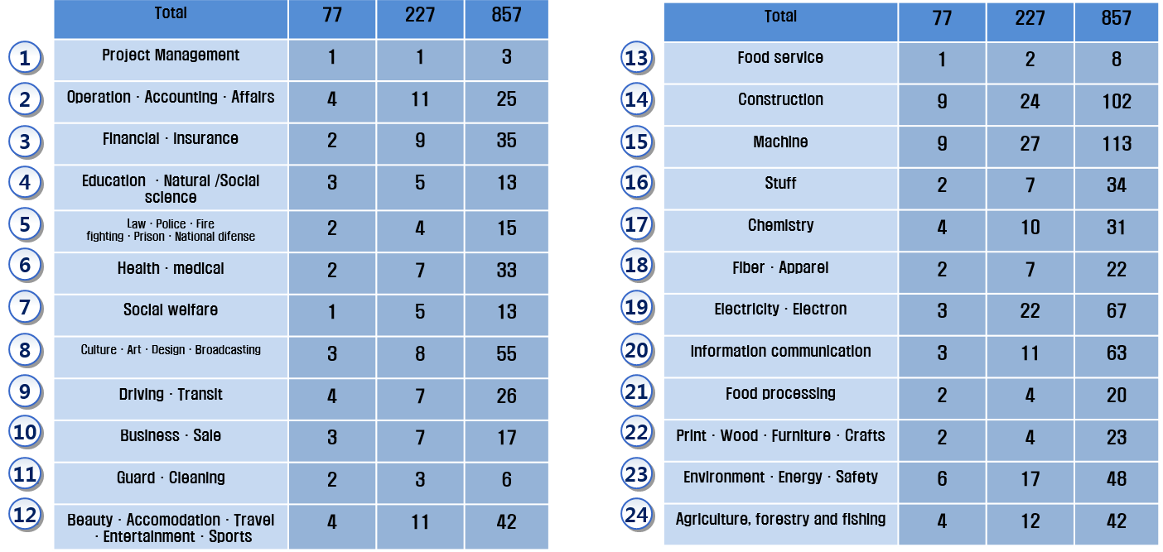
Development Area of NCS

Slide 7
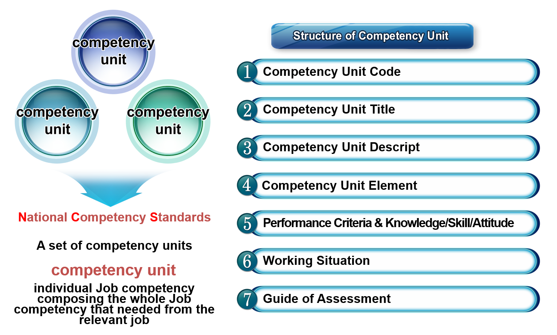
Composition of NCS

Slide 8

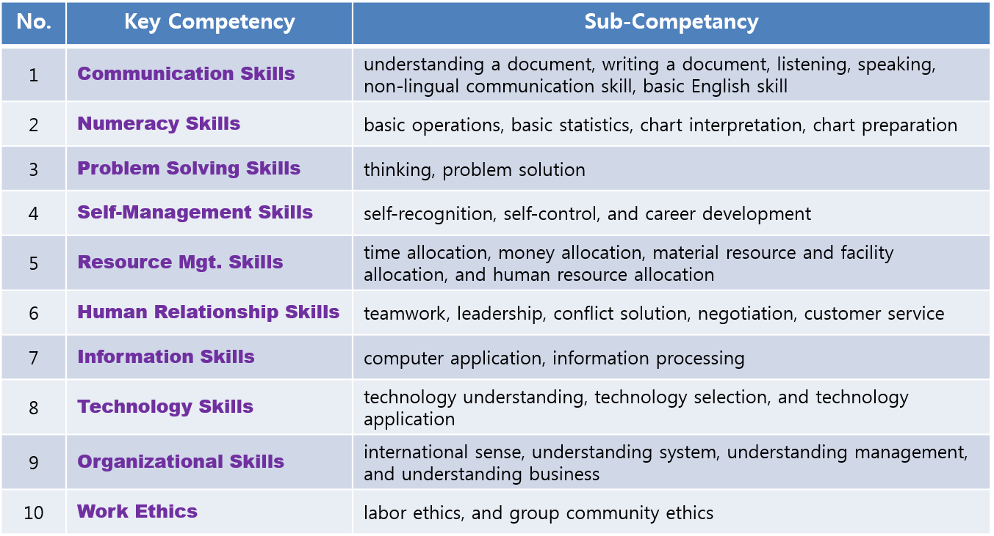
Key Competency

Slide 9
Sample of Competency Unit

Slide 10
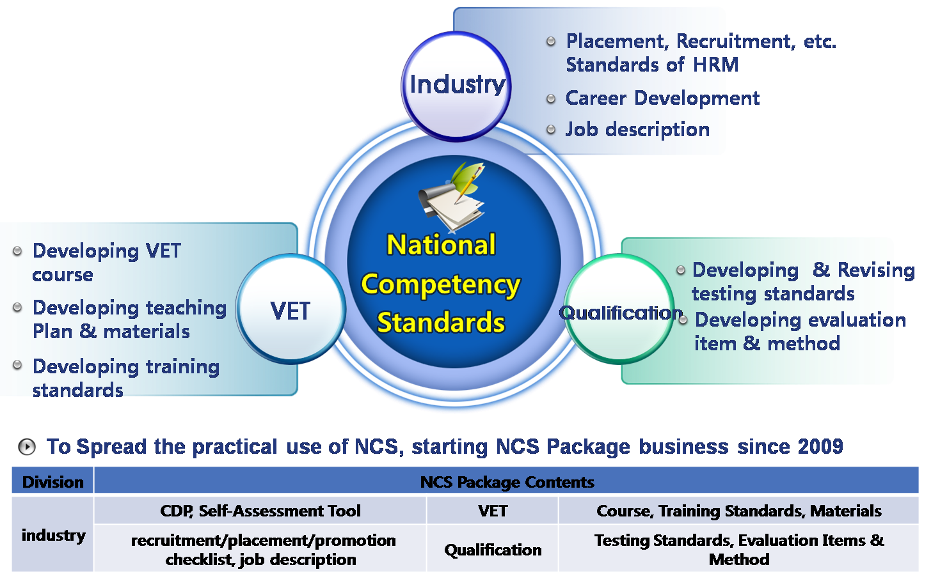
Range of NCS Use

Slide 11
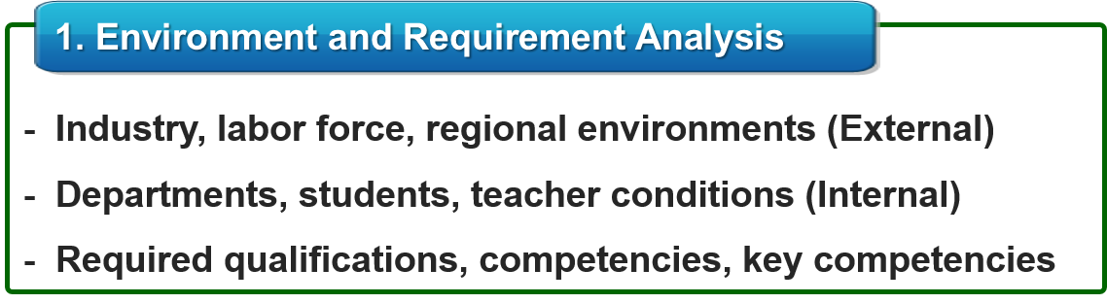



Design Process of Module Course with NCS

Slide 12



Design Process of Module Course with NCS

Slide 13



Design Process of Module Course with NCS

Slide 14
Guideline for VET Courses
for Education Course based on NCS
for Training Course based on NCS

Slide 15
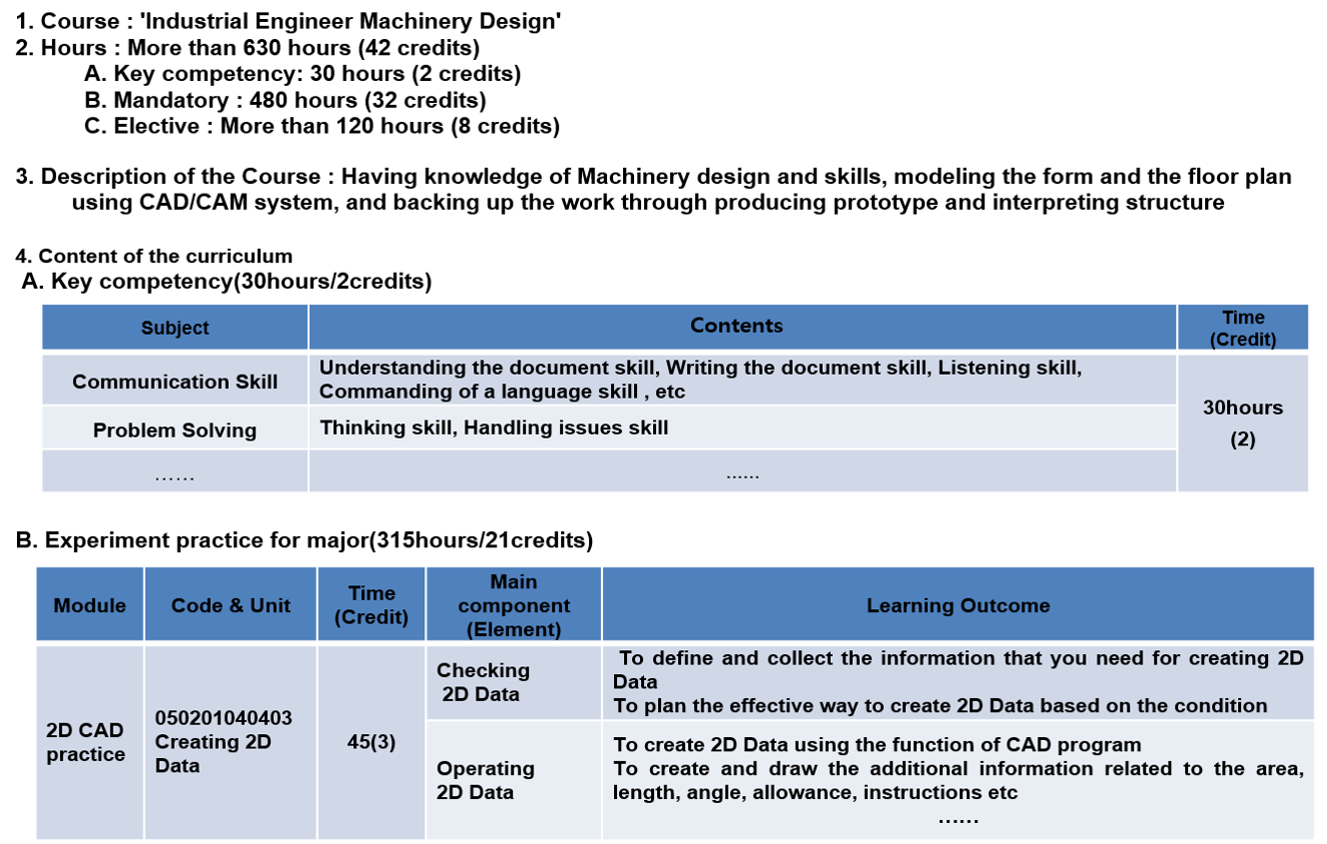
Sample of Course with NCS

Slide 16
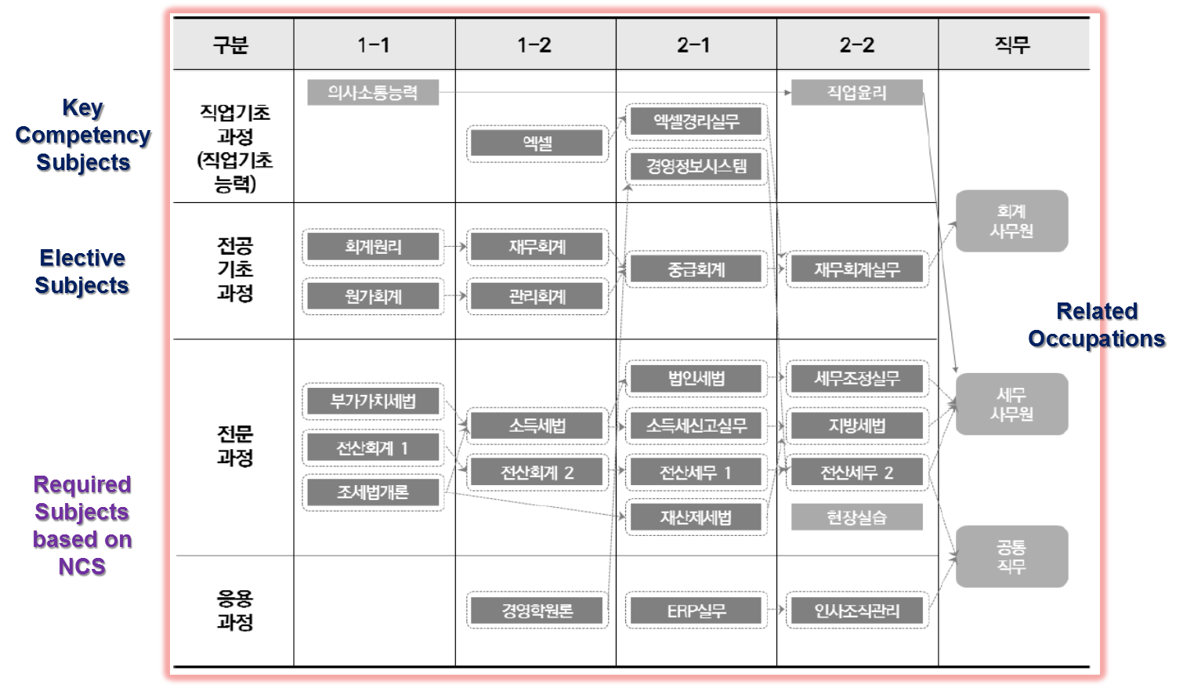
Sample of Curriculum Roadmap

Slide 17



