Slide 1

TPQI Workshop
Breakout Session
Part1
A Way to Make Good Bases for Global HRD
June, 2015
Ogawa, Kenji
VP of IT Human Resource Development HQ
Information-technology Promotion Agency, Japan
http://www.ipa.go.jp/index-e.html
Notes:
お早うございます。
タガログ
マヨン ハガ
こんにちは
タガログ
マガンダ（ング） ハポン ング←小文字
セブアノ、ビサヤ
マヨン ハポン
私は小川です。
アコ シイ オガワ アイシイ←小文字
どうもありがとう
タガログ
マラーミン（グ） サラマポウ
セブアノ、ビサヤ
サラマット カーヨ
小川
タガログ
イーログ ilog（？）
セブアノ、ビサヤ
サパ（↓）

Slide 2
Introduction
Information-technology Promotion Agency(IPA)
IPA is
an Independent Administrative Agency, sponsored by Ministry of Economy, Trade and Industry (METI).
Our role is
METI makes IT policies
IPA realize their IT Policies
  Solve diverse IT issues
  Create an IT-based society
Contribute to achieve Safe, Secure, and Reliable IT Society

Slide 3
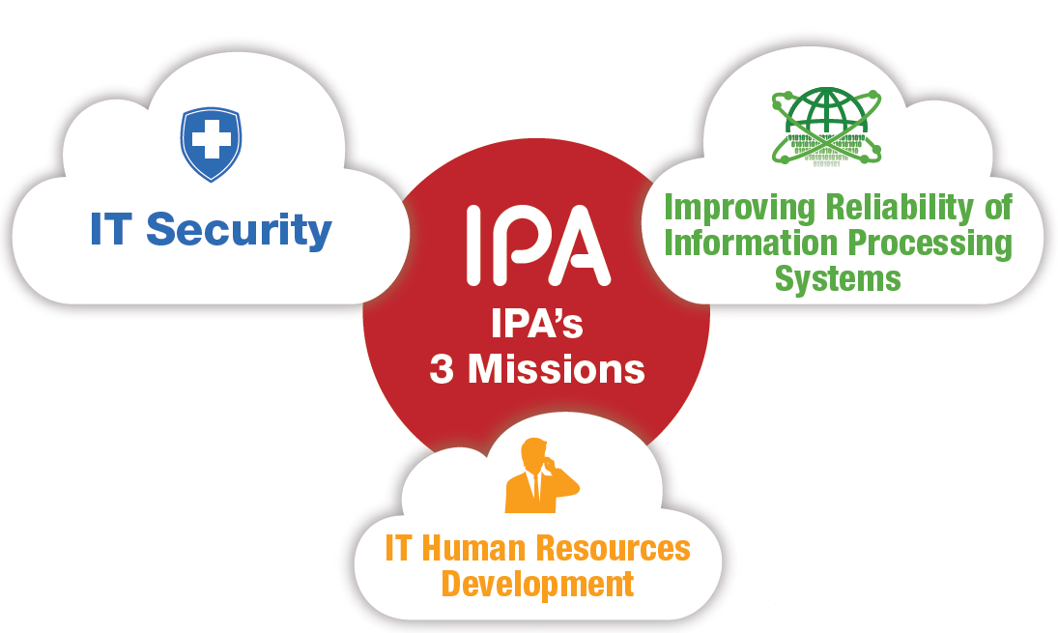
IPA’s Missions & Principal Fields
Three Principal Fields
1. Creating a Secure and Reliable IT-based Society
2. Creating a Better IT Future
3. Connecting Japanese IT with the World

Slide 4

Mission of IT HR Development HQ
Implementation
of
IT Engineers
Examination
(ITEE)
Strengthen
collaboration
with
Asian countries
Operation of
Skill Standards for
IT Professionals
(ITSS)
Exploratory
IT Human
Resource Project
(the MITOH
program)
Advance IT for
SMEs and
local
communities
Notes:
１．ITスキル標準の運用
高度IT人材像の明確化と客観的な評価メカニズムの提供
２．情報処理技術者試験の実施
国家試験としての情報処理技術者試験の実施
３．未踏人材発掘育成
突出した逸材「スーパークリエーター」の発掘
次世代の日本のIT産業界を担うグローバルに通用する人材の育成
４．中小企業と地域のIT化推進
中小・中堅企業のIT化支援
地域におけるIT人材の育成を通してIT化に遅れる知己が出ないように支援
５．アジア各国との連携強化
ソフトウェア技術および市場のグローバル化に伴う国境を越えたIT人材の育成と確保
産学連携の推進
産業界で即戦力として通用するIT人材の育成

Slide 5
Concept of Skill Standards

Slide 6
Japanese Industry Needs High Competence ICT professionals
HR development
problems faced
by companies
Factor caused
by change in business environment
Severe
shortage of
skilled
IT Professionals
Difficulty
in identifying
and training
Human Resources
Shift from
“Product”
to
“Services”
Increase of
Offshore
Development
(China, India etc.)
Diversified needs in IT service industry
Greater specialization in skills
Definition and Promotion of Skill Standards
Skill standards as common criteria for IT related industry
Notes:
企業が抱える人材育成の問題点
高度なIT人材が圧倒的に不足
必要なスキルを持った人材の把握・育成が困難
（パートナーを含めたIT人材のレベルの評価が困難）
（プロフェッショナルの育成市場・手段が貧弱）
（スキル保有度合いを評価する基準が不明確）
環境の変化が及ぼす要因
「モノ売り」の時代から「サービス」の時代へ
オフショア調達の進展
情報サービス産業における顧客のニーズの多様化
必要スキルもそれぞれのニーズに対応するために専門家・深化
IT人材に求められる実務能力を体系化した基準
「スキル標準」の策定・普及が必要
ITサービスの提供に必要な実務能力を体系化した「スキル標準」の普及
個々の人材を育成し、管理していくスキームが企業の競争力に直結

Slide 7
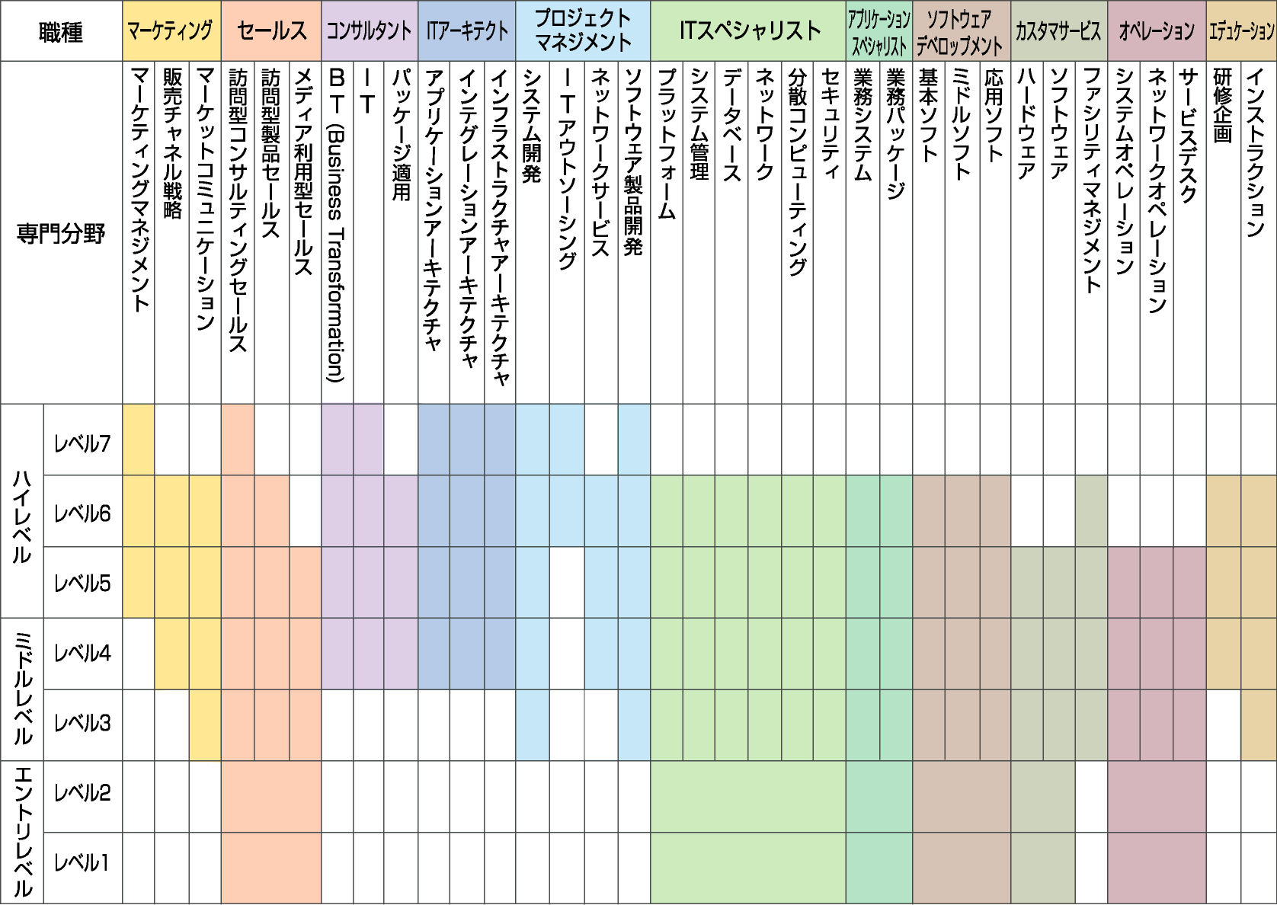
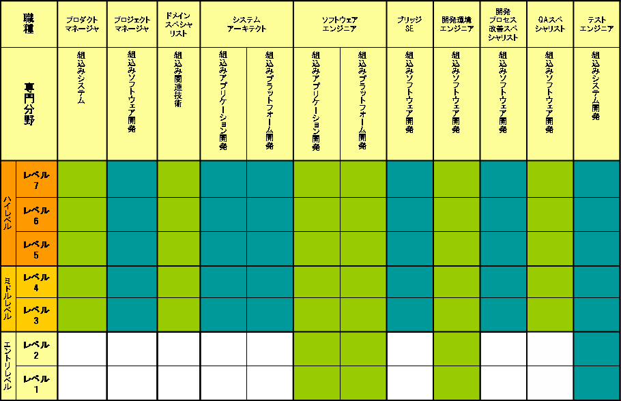
Skill Standards family in Japan
Skill Standards for IT Professionals (ITSS)
Dec/2002 -
- Target: IT service vendor
- Indices of business capability
- Common definition of job career and level
- Level assessment by KPI
Embedded Technology Skill Standards (ETSS)
May/2005 -
- Target: Industrial Software developer
- Skill Standards for embedded technology software
Users' Information Systems Skill Standards (UISS)
Jun/2006 -
Target : Information System functions
in IT user company
- Skill Standards for Information System users

Slide 8
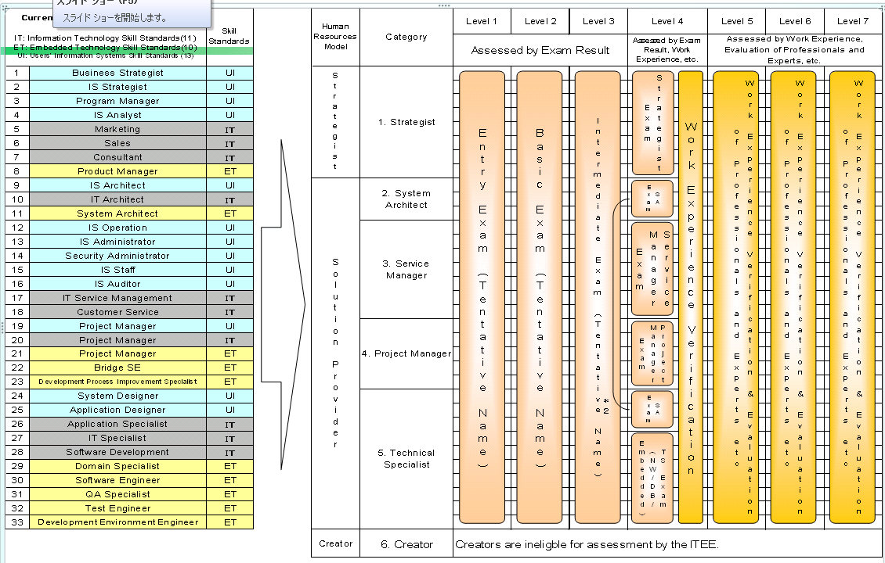
Umbrella concept for Skill Standards family
Common Career & Skill Framework
Users' Information Systems
Skill Standards
Skill Standards for IT Professionals
Embedded Technology
Skill Standards

Slide 9
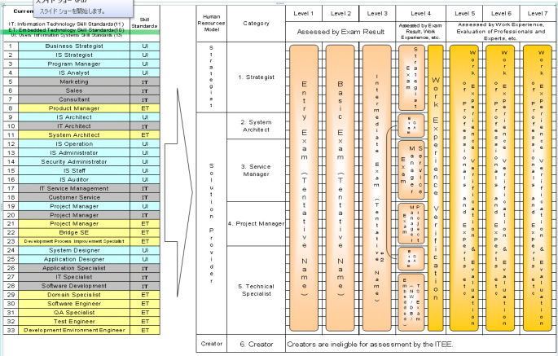
Common Career and Skill Framework as a reference model in Japan
Information
Technology
Engineers Exam.
(ITEE)
Skill Standards
for IT Professionals
（ＩＴＳＳ）
Conform
Body of Knowledge
Users' Information
Systems
Skill Standards
（ＵＩＳＳ）
Embedded
Technology
Skill Standards
（ＥＴＳＳ）

Slide 10
International & Defacto Standard
ITSS/ITPE
・Coverage Evaluation
・Latest Technology
・Latest Environment
BoK
Activity & Tasks
ISO/IECTR 19759
(ＳＷＥＢＯＫ)
ＳＱｕＢＯＫ
ETSS
ITEE/ITPE
UISS
…
…
ＩＳＯ21500
（Proj.-Mgm’t）
ＩＳＯ２００００
（ＩＴＩＬ）
ＩＳＯ15288
（ＩＴＩＬ）
ＩＳＯ/IEC 24773
（Certification）
Education Curriculum
ＣＣ2005 （Ｊ０７）
Notes:
どの標準を参照すべきか
参照するときの考え方、タイミング、内容
取り込み方

Slide 11
IT Skill Standard is …
The Key Performance Index, which identifies and systematize business capabilities for IT service industry.
It provides Framework for the education and training of IT professionals in businesses and universities.
Visualization of invisible skills （business capability）

Slide 12
3. Job Category and Specialty Field
Job Category | Specialty Field
Marketing | Marketing Management
 | Sales Channel Strategy
 | Market Communication
Sales | Consulting Sales by Visiting
 | Customers Product Sales by Visiting Customers
 | Sales via Media
Consultant | Industry
 | Business Function
IT Architect | Application Architecture
 | Integration Architecture
 | Infrastructure Architecture
Project Management | System Development
 | IT Outsourcing
 | Network Service
 | Software Product Development
Job Category | Specialty Field
IT Specialist | Platform
 | Network
 | Database
 | Common Application Infrastructure
 | System Management
 | Security
Application Specialist | Application System
 | Application Package
Software Development | Operation System
 | Middleware
 | Application Software
Customer Service | Hardware
 | Software
 | Facility Management
IT Service Management | Operation Management
 | System Management
 | Operation
 | Service Desk
Education | Training Planning
 | Instructions
12
Notes:
12

Slide 13
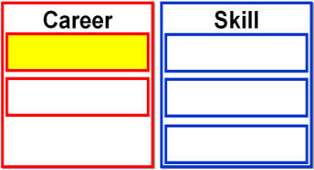

(1)Common Career Framework
Analogies of “Job category”
By defining an Job category and a Specialty field, we can
effectively develop human resource and provide services.
IT engineer
Doctor
Marketing
Sales
Consultant
IT Architect
Project Management
IT Specialist
Application Specialist
Software Development
Customer Service
IT Service Management
Education
surgeon
eye doctor
pediatrician
We can understand IT
skill necessary for the
IT engineers because
Job category and
Specialty field are
classified systematically.
We can assign an
adequate job based on
IT engineer skill.
Even if the doctor
is a common occupation, required skills different with Specialty fields.
Application System
Application Package
cardiac surgery
orthopedic surgery
All Rights Reserved, Copyright©IPA2012
13

Slide 14
Level Definitions
Level | Definition
Level 7 | World-class, high-end player with advanced knowledge and skills Defined as human resources recognized throughout the world who have experience and achievements in successfully leading development, reforms, and marketing of industry leading services. (Top class in the world)
Level 6 | Nation-level, high-end player with advanced knowledge and skills Defined as human resources widely recognized inside and outside their organizations who have professional experience and achievements not only within their organizations but also in the industry. (Top class in Domestic)
Level 5 | In-house, high-end player with advanced knowledge and skills Defined as professionals who have rich experience and achievements to lead their organizations. (Top class in Company)
Level 4 | Defined as professionals with advanced knowledge and skills who are able to perform tasks and deliver work instructions based on experience and achievements as well as to formulate the experience required for professionals as formal knowledge to develop younger people. (Leader)
Level 3 | Defined as human resources with practical knowledge and skills who are able to perform all required tasks on their own. (By oneself)
Level 2 | Defined as human resources with basic knowledge and skills who are able to perform tasks with a certain degree of difficulty or part of the required tasks on their own. (Assist)
Level 1 | Defined as human resources with the minimum knowledge and skills required for people involved in information technology who are able to perform tasks under guidance. (Follow)

Slide 15


Level Concept
Top class
in the World
Level 7
Level 6
Top class
in Domestic
Level 5
Top class
in a Company
Level 4
Leader
Level 3
By oneself
Level 2
Assist
Level 1
Follow (Chicken)
15
Notes:
15
Philippine Eagle

Slide 16
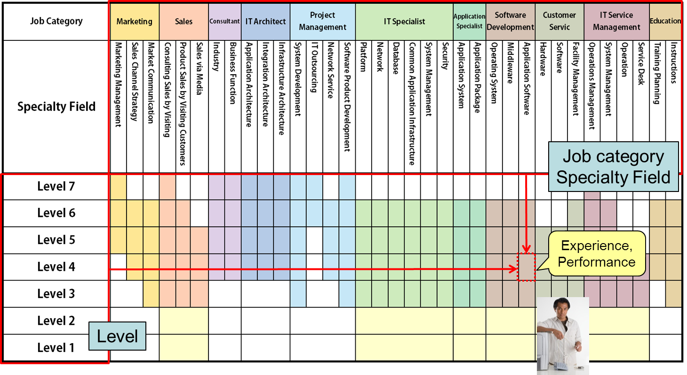
2. What is IT Skill Standards？
The career framework shows an overall view of ITSS and can be utilized to design and plan HRD strategies and career paths.
-Define 11 Job Categories, 35 Specialty Fields, and 7 levels in the matrix chart
-Define Job descriptions of all Job Categories and Specialty Fields
-Assess Level by the unique indicator which includes skills, business result and experience
Skill,
Experience,
Performance
16
16
Notes:
16

Slide 17
Project Size and Complexity
 | SMALL | MEDIUM | LARGE
Complex | SMALL Complex | MEDIUM Complex | LARGE Complex
Medium | SMALL Medium | MEDIUM Medium | LARGE Medium
Light | SMALL Light | MEDIUM Light | LARGE Light
Competency
Level
Complexity
□Mission critical system with high quality
□Applications of multi-platforms
□24 hours a day & 365 days continuous operation
:
Project scale
□ 50 persons or more during peak periods
□ 10 or more but less than 50 persons during peak periods
□ 3 or more persons during peak periods
:

Slide 18
2. Concept of how to determine Level
It is difficult to evaluate experience/actual performance
by examinations only.
ITSS Level
Experiences
and
actual
performance
Skills
and
Knowledge
ITSS
・To determine the level, ITSS evaluates not only skill/knowledge but also experience/actual performance. This feature tends to be stronger in higher level.
・Level is basically determined by self-assessment and interview with manager by using KPI/Skill proficiency
ITPE(Information Technology Professional Examination)
・ITPE can be used to evaluate level-1 through level-4
・ITPE is one of the objective certification for the IT engineers/professionals
Examinations

Slide 19
Use Examinations as a level evaluation tool.
ITSS
Level
Basic concept for assessment
Consideration
Examination
Level
Experience
and
performance
Skills and
knowledge
Effective
Use of ITPE
Simplified
assessment
Users’
convenience
≒Evaluation of
Competency
Experience and performance
Level 5 and more
Level 4
High-level Exam. & work experience
Level 3
Passing of AP
in ITEE
Level 2
Passing of FE
in ITEE
Level 1
Passing of IP
In ITEE
Notes:
19
ITSS is based on the learning through experience. It encourages to acquire fundamental knowledge in lower levels.
・ITEE as effective assessment tools. User’s convenience and simplified assessment.
・Individuals are regarded as attaining the level 1,2 and 3 of ITSS, by passing ITEE in relevant levels.
・High-level Examinations are available for skill proficiency assessment in level 4
レベル１は、指導を受けて業務を遂行するレベル
レベル２は、一部の業務は独力で遂行できるレベル
レベル３は、担当業務はすべて独力でできるレベル
レベル４は、プロフェッショナルとして業務を遂行でき、後進の指導もできるレベル
としています。
レベル１～３は試験を活用して評価して行きましょうということです。
レベル４は、試験に加え、業務経歴などで経験と実績を併せて評価していきましょうということです。
-------------------------------------------------------------------------------------
良く質問されることとして、新試験と旧試験の対応についてどうなのかということを聞かれるのですが、新旧試験の対応そのものは、先ほど試験センターからご説明がありましたので省略いたしますが、ITスキル標準としては旧試験の合格をもってレベルを認めるのかということについては、基本的には、いいのではないかと考えております。
ただ、１０年、２０年前に一種に合格していて、対比表があるからといった話になりますと、それを評価に使うかどうかは、各企業の判断でやっていただきくしか無いと思います。 （スクリーン次へ）
-------------------------------------------------------------------------------------

Slide 20
IT Engineer Examination
ITPEC

Slide 21
ITEE Overview
ITEE/ITPE is
ITEE/ITPE is a national examination based upon the Act by which METI (Ministry of Economy, Trade and Industry) recognizes IT engineers as possessing a given level of knowledge and skills.
Objectives are
For IT engineer
For Industry, Academia
To improve technical competence of individuals.
To indicate the levels of competence required for various fields of IT engineers.
To raise social status of qualified engineers.
Motivation for self-upgrading
To act as guidelines in education and training.
To establish an objective criteria for evaluating skill and competence of IT engineers.
A Yardstick to Objectively Evaluate IT Human Resources

Slide 22

ITEE Overview
When started?
1969
2 Exam categories 42,000 examinees
ITEE was launched in 1969
Concern from the industry fearing shortage of skilled IT engineers.
Voices from IT engineers seeking recognition of their knowledge and skills.
Heavy industries
IT industries
2015
12 Exam categories 400,000 applicants/year

Slide 23
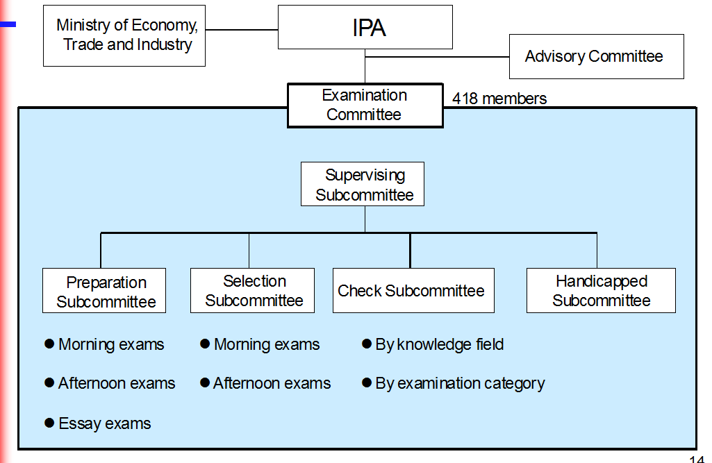
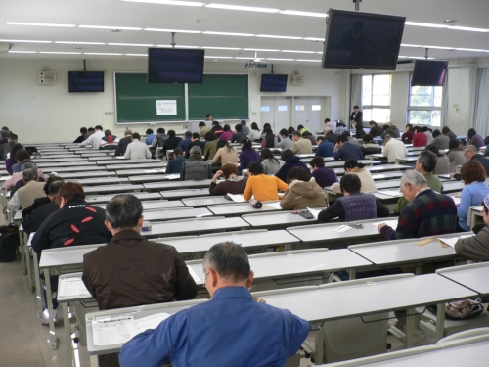
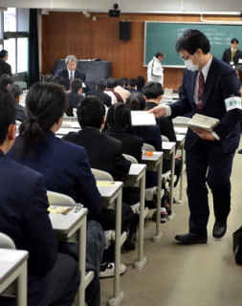
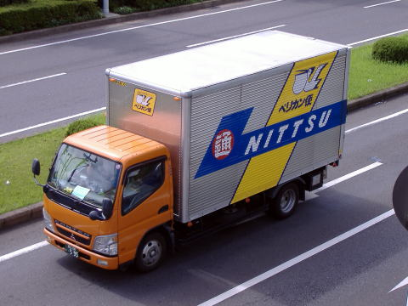

Largest National Examinations
Spring 2014 in Japan
More than 400 Examination Committee Members
Applicants: 182,569
Examinees: 118,692
Venues: 199
Rooms: 2,808
Staff: 6,400
Delivery Vehicles: 551

Slide 24
Type of Examinations
LEVEL4
LEVEL4
Expert in each area
LEVEL3
Proof of full grown engineers
LEVEL3
Applied Information Technology Engineer Examination
LEVEL2
LEVEL2
Fundamental Information Technology Engineer Examination (FE)
Fundamental Information Technology Engineer Examination (FE)
Gateway to be IT Professionals
LEVEL1
Information Technology Passport Examination (IP)
LEVEL1
Information Technology Passport Examination (IP)
Passport to success in Business Society

Slide 25
Vendor Exam-ITEE
2. Comparison between Vendor Exams & ITEE
 | Vendor Examination | IT Professional Examination (ITPE)
Summary | Certification for knowledge , operation and management technology for vendor specific products and services | Certification for most of Vendor Independent skill, knowledge and technology required for IT professionals
Objective | For authorization on knowledge and skill to operate and manage specific products/services | For authorization on knowledge and skill required for IT professionals
Target Person | Mainly vendor product/services administrators, developers and users | Mainly IT Professionals
Certificate | Vendor | National Certification
Example | CISCO, IBM, Microsoft, Oracle etc. | ・IT passport ・Fundamental IT Engineer Exam(FE) ・Applied IT Engineer Exam (AP)
Sample Question Topic | ・How to solve Cisco’s router trouble ・How to tune Oracle database ・How to build MS Active directory | Fundamental Knowledge ・Binary arithmetic operation ・How to assign IP address ・What is database etc.

Slide 26
Mutual Certification in Asia
October, 2000. Chiang Mai, Thailand,
ASEAN + Japan, China and Korea
Economic Ministers’ Meeting
Mr. Hiranuma, Minister of Economy, Trade and Industry proposed:
Asian Common Skill Standard Initiative
for IT Professionals/Engineers
○ Use experience and know-how in IT examination fields.
- Establish examination system for IT engineers in Asia
○Mutual certification based on skill standards
IT human resource development in Asian countries
Promotion for mobility of IT Professionals/Engineers
More effective use of IT engineers in Asia
Notes:
IT人材施策のアジア展開
２０００年10月ASEAN＋日中韓経済閣僚会議（タイ王国；チェンマイ）にて平沼経済産業大臣が「アジアITスキル標準化イニシアチブ」を提唱しました。
アジア地域で我が国の情報処理技術者試験の経験・ノウハウを活用して、IT技術者を対象とする試験制度を創設し、スキルスタンダードベースでの相互認証を通じ、アジア各国のIT人材育成を支援しアジア地域でのIT人材の流動性の向上、有効活用をはかっていこうとするものです。
提案の背景と相互認証の効果
背景：
アジア諸国（タイ、フィリピン、韓国等）から我が国の情報処理技術者試験制度について関心が示されていた。
効果：
① 各国（例えば日本）にとって、他のアジアのＩＴ技術者を受け入れる
際の客観的な能力評価の判断基準となる。
② 海外に進出している企業（例えば日本企業）にとっては、現地の
ＩＴ技術者の採用のコスト・リスクを軽減し得る。
③ アジア各国の企業がソフトウェア開発において業務提携を組みや
すくなる。
④ 各国のＩＴ技術者にとっても、海外での就職や自国に進出している
外資への就職の際の能力を示す指標となる。
就労が認められている在留資格取得の要件の１．が緩和されます。
現在は、インド、シンガポール、韓国、中国、フィリピン、ベトナムの６か国が対象です。

Slide 27

IT Professionals
Examination Council
ITPEC: IT Professionals Examination Council
Formed to coordinate the exams using the same questions, on the same time, same date, starting April 2006
Current Members:
  Philippines, Thailand, Vietnam, Myanmar, Malaysia and Mongolia, Bangladesh.
Total No of Applicants of ITPEC Examination till Oct./2014 : 47,991

Slide 28
Why Mutual Certification?
To accelerate the movement of IT engineers in Asian countries
  Preferential Immigration Treatment into Japan
To establish common standards for the skills of IT engineers within the Asia.
To promote the movement of IT engineers in Asian countries
To reduce costs and risk to companies expanding business overseas when hiring local IT engineers.
To make it easier for companies in the area to establish business alliances for software development.
To provide a common measure for IT engineers seeking employment.
Notes:
提案の背景と相互認証の効果
背景：
アジア諸国（タイ、フィリピン、韓国等）から我が国の情報処理技術者試験制度について関心が示されていた。
効果：
① 各国（例えば日本）にとって、他のアジアのＩＴ技術者を受け入
れる際の客観的な能力評価の判断基準となる。
② 海外に進出している企業（例えば日本企業）にとっては、現地の
ＩＴ技術者の採用のコスト・リスクを軽減し得る。
③ アジア各国の企業がソフトウェア開発において業務提携を組みや
すくなる。
④ 各国のＩＴ技術者にとっても、海外での就職や自国に進出してい
る外資への就職の際の能力を示す指標となる。
就労が認められている在留資格取得の要件の１．が緩和されます。
現在は、インド、シンガポール、韓国、中国、フィリピン、ベトナムの６か国が対象です。

Slide 29
Mutual Certification & MOU other than ITPEC
 | Examination Agency | Examination Category
 |  | PM | AE SA | NW | DB | SW AP | FE | AD IP | SU SC
India* | NIELIT |  | C Level |  |  | B Level | A Level
Singapore* | Singapore Computer Society (SCS) | CITPM
Korea* | Human Resources Development Service of Korea (HRD Korea) |  |  |  |  | Information Processing Engineer | Information Processing Industrial Engineer | Information Instrument Operation Craftsman
China* | Electronic Education & Examination Center (CEIAEC) |  | System Analyst | NW Engineer | DB System Engineer | Software Development Engineer | Programmer
Chinese Taipei** (Taiwan) | Institute for Information Industry(III) / Computer Skills Foundation (CSF) |  |  | Network Communication |  | Software Design and Development |  |  | System Analyst
*:Mutual Certification
**: Memorandum of Understanding

Slide 30
  Preferential Immigration Treatment into Japan
Mongolia (Aug. 2007)
（NITP)
Korea (Dec. 2001)
（HRD Korea ）
China (Jan. 2002)
（EIEC ）
India (Feb. 2001)
（NIELIT)
Chinese Taipei (Dec. 2003)
（III & CSF ）
Myanmar（Nov. 2002）
(MCF)
Vietnam（Jul. 2002）
(VITEC)
Thailand （Jun. 2002)
（NECTEC)
Philippines （Apr. 2002）
（PhilNITS Foundation)
Malaysia (Jan 2005)
(METEOR)
Bangladesh
(New Member)
Singapore（Aug 2001）
（SCS）

Slide 31
To Be Continued!
IPA (Information-Technology Promotion Agency, Japan
IT Human Resource Development Headquarters
Center for Human Resources Development Initiative
ITPE(IT Professional Examination) by NSTDA
http://www.nstdaacademy.com/webnsa/index.php/sss
ITSS Documents(English Edition) Download URL:
http://www.ipa.go.jp/english/humandev/forth_download.html
31
31
Notes:
Confidential機密性2
機密性2

