Slide 1
GTDEE Introduction
Dual Vocational Education & Training from Germany

Slide 2
Perception of DUAL
The DUAL process theory of thought!
College
Company
Learning
Student
Teacher
Lesson
Knowledge
Working
Employee
Supervisor
Production
Earning

Slide 3
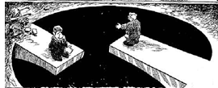
Dual Confusion
Key to Dual Vocational Education and Training (DVET)
The Dual Confusion
Company
College
The Dual Solution
DUAL

Slide 4
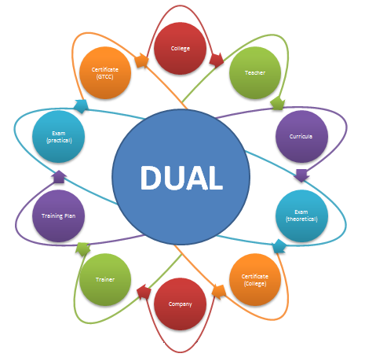
The DUAL Process
The DUAL process made in Germany!
DUAL
Dual Vocational Education includes at least:
2 Learning venues
2 Apprenticeship mentors
2 Curricula
2 Examinations
2 Certificates

Slide 5
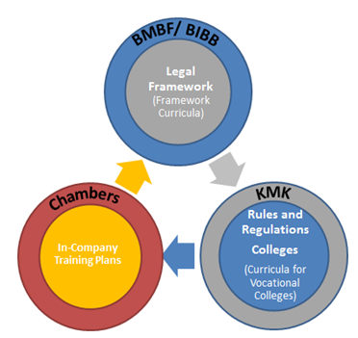
Curricula Guideline
The DUAL process made in Germany!
BIBB
Chambers
KMK
Occupational Sectors
Duration of training
Skills & Competences
Subjects College
Methods and Medias
Learning Aids
Administration
Examinations
Certifications

Slide 6
Curricula Guideline
The DUAL process made in Germany!
Input
(Guidelines)
Process (Lessons)
Output
(Success)
Outcome (Skills)
Ordinance VET
School Curricula
On Job Training Plan
Workshops
Learning Environment
Methods
Media
Learning success
Learning objectives
Assessment of Learning Objectives
Professional skills
Competences
Curricula
Examination
Learning environment
Learning and working
Working process
and learning transfer
Standard
Learning in college
Confirmation of competences
Learning in company

Slide 7
Corporate purpose and positioning of the department
German-Thai Dual Excellence Education (GTDEE)
How we differentiate?
GTDEE can authorize German Certificate for apprentices and trainers
GTDEE provide bright carrier path (focus on a wide field of competences)
What is GTDEE?
Part of VETnet Programme
Dual Vocational Education Programme of GTCC (AHK-Thailand)
Two year vocational education programme with dual approach (Higher Voc. Education)
Supported by German and Thai Ministries
German Certification (AHK-Certificate)
Why we exist?
To establish “Premium Standard” from Germany in Dual Vocational Education in Thailand.
To support the demand of skillful labor in industries.

Slide 8
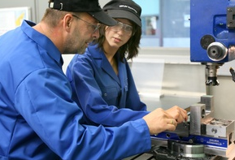
Essentials in DUAL Vocational Education
The DUAL process made in Thailand!
DUAL
VOCATIONAL EDUCATION & TRAINING
Training is mainly
provided in the company -
supported by teaching in part-time vocational schools
Company:
3-4 days a week
on the basis of training regulations within the framework of a training contract
Vocational School:
1-2 days per week on average, on the basis of a framework curriculum
Joint Responsibility !!!
because companies are involved in
Vocational Education and Training (VET)

Slide 9
GTDEE Strategy
Suitability Check
A: Company & College Selection:
Company suitability
Operational suitability
Personal suitability
B: Student Selection:
Graduate with four required subjects related to selected profession
Pass Aptitude Test (practical and theoretical part).
Company Interview

Slide 10
Successful Training
The DUAL process made in Germany!
Interaction
Successful Training
Training
Experience
Knowledge
Knowledge is a result of interaction, context-sensitive experience and the right training

Slide 11
Skills & Competences in DVET
The DUAL process made in Thailand!
Essential Skills and Competences
in DVET
Skills on the job
Teamwork
Problem solving skills
Technical Understanding
Planning of proper work process
Flexibility at the workplace
Skills near the job
Self critics
Work behaviors
Organize and conduct project
Learning transfer
Ability to present
Skills off the job
Logical Thinking
Technical Understanding
AQ (Adversity Quotient)
Creativity
Time Management
Successful Training always covers Skills and Competences from all areas (Skills on / off / near the job)!

Slide 12
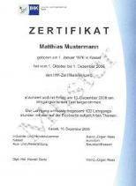
Examination Procedure
The DUAL process made in Germany!
PAL Examination
theoretical
theoretical work
Task A
1,5 h
40%
Task B
practical
strategy work task
0,5 h
60%
execution work task
4 h
control work task
2h

Slide 13
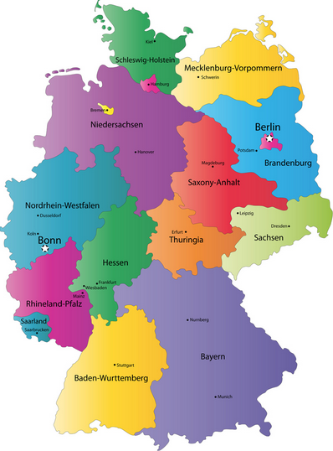
German Standard Examination (PAL)
What is PAL?
PAL is the development center for examination questions and training materials in industrial/technical professions within the dual system for vocational training.
The PAL of IHK Region Stuttgart was founded in 1948 as a joint institution of the Chambers of Industry and Commerce (IHKs) in order to promote the development of industrial/technical examinations.
Since then, the PAL Examination has been established as a German Standard Examination which is comparable all over Germany.

Slide 14
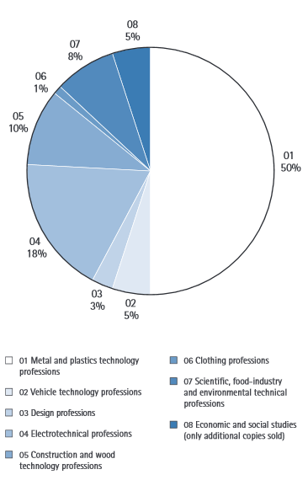
Covered Professions
As the central examination institution of the IHKs, PAL covers a wide spectrum of industrial/technical professions. Currently, it provides theoretical, practical and integrated intermediate and final examinations for 131 Professions.
First PAL Examination usually after 18 month of apprenticeship programme. About 50% of all the professions covered by PAL are in the metal and plastics technology sector.

Slide 15
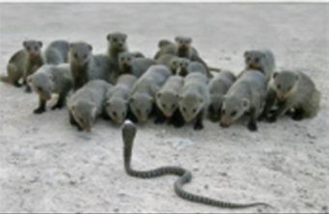
Skills screened in Examinations
PAL
REQUIREMENTS
Logical thinking
Problem solving
Teamwork
Work planning

Slide 16
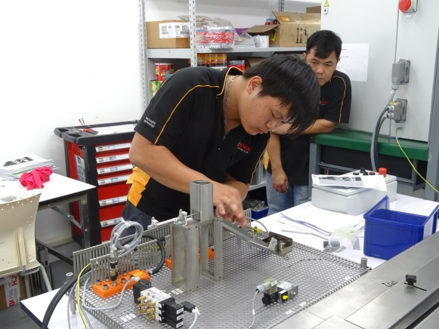
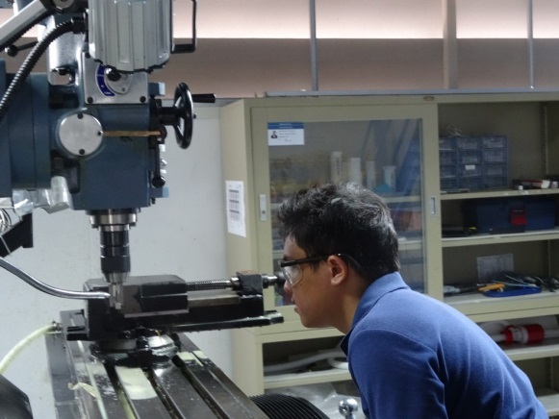
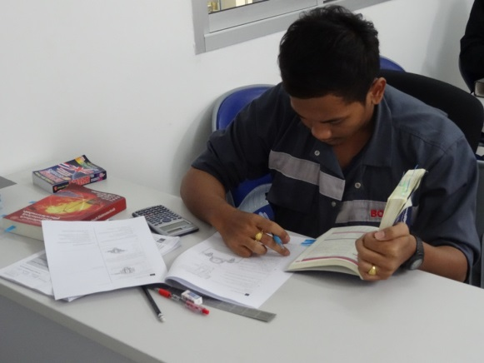
Examination Procedure
Theoretical Part
Task A: Multiply Choice
Task B: Written task
Timeframe related to professions
2. Practical Part
The practical Examinations are tailor-made for the individual professions and mainly screen the technical understanding, as well as problem solving skills, and the ability of planning work tasks.

Slide 17
Evaluation and Certification
Evaluation Procedure:
Just one answer can be selected!
Timeframe as announced in Examination!
Task A = 40% / Task B = 60 %
The Examination is passed if more than half of the total score is achieved!

Slide 18
Qualification System
GTDEE Qualification System
Points in percent | Grade in letters | Grade in Numbers
100 -92 | A | 4
91 -87 | B+ | 3,5
86 – 81 | B | 3
80 -74 | C+ | 2,5
73 - 67 | C | 2
66 -59 | D+ | 1,5
58 -50 | D | 1
< 50 | F | 0
* IHK Qualification System Germany

Slide 19
Career Development
GTDEE Apprentice
(Higher Voc. Ed.)
GTDEE PLUS Apprentice
High School
Lower Voc. Education
GTDEE Mentor Programme
MEISTER Programme (University Degree)

Slide 20
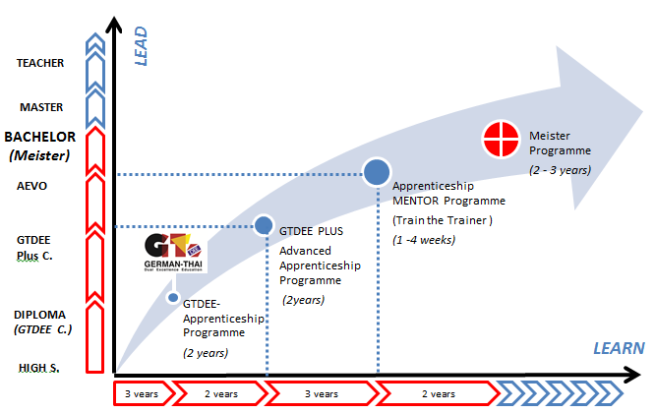
Career Path Development

Slide 21
Thank You
Any Questions?
Follow us on:
GTCC:
http://thailand.ahk.de/berufsbildung/gtdee-programm/
GTDEE Website:
http://gtdee.com/en
Facebook:
https://th-th.facebook.com/Gtdeeproject
LinkedIn:
http://th.linkedin.com/pub/gtdee-thailand/88/b53/710
Supported by:
Philipp Dreher
GTDEE Project Director
GERMAN-THAI CHAMBER OF COMMERCE

