Slide 1

TPQI Workshop
Breakout Session
Part2
A Way to Make Good Bases for Global HRD
June, 2015
Ogawa, Kenji
VP of IT Human Resource Development HQ
Information-technology Promotion Agency, Japan
http://www.ipa.go.jp/index-e.html
Notes:
お早うございます。
タガログ
マヨン ハガ
こんにちは
タガログ
マガンダ（ング） ハポン ング←小文字
セブアノ、ビサヤ
マヨン ハポン
私は小川です。
アコ シイ オガワ アイシイ←小文字
どうもありがとう
タガログ
マラーミン（グ） サラマポウ
セブアノ、ビサヤ
サラマット カーヨ
小川
タガログ
イーログ ilog（？）
セブアノ、ビサヤ
サパ（↓）

Slide 2
Concept of Evaluation of
IT Human Resource

Slide 3
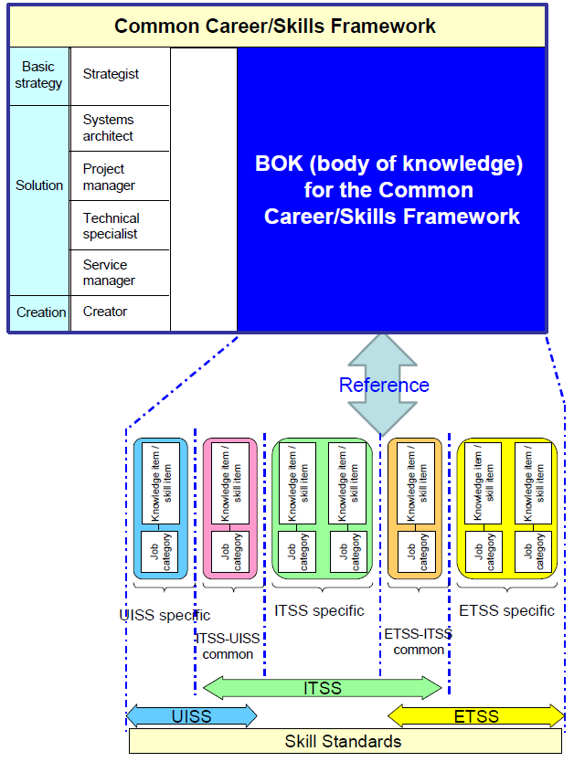
Body of Knowledge
Conform
Examination Syllabus

Slide 4
Body of Knowledge (BOK) Part

Slide 5
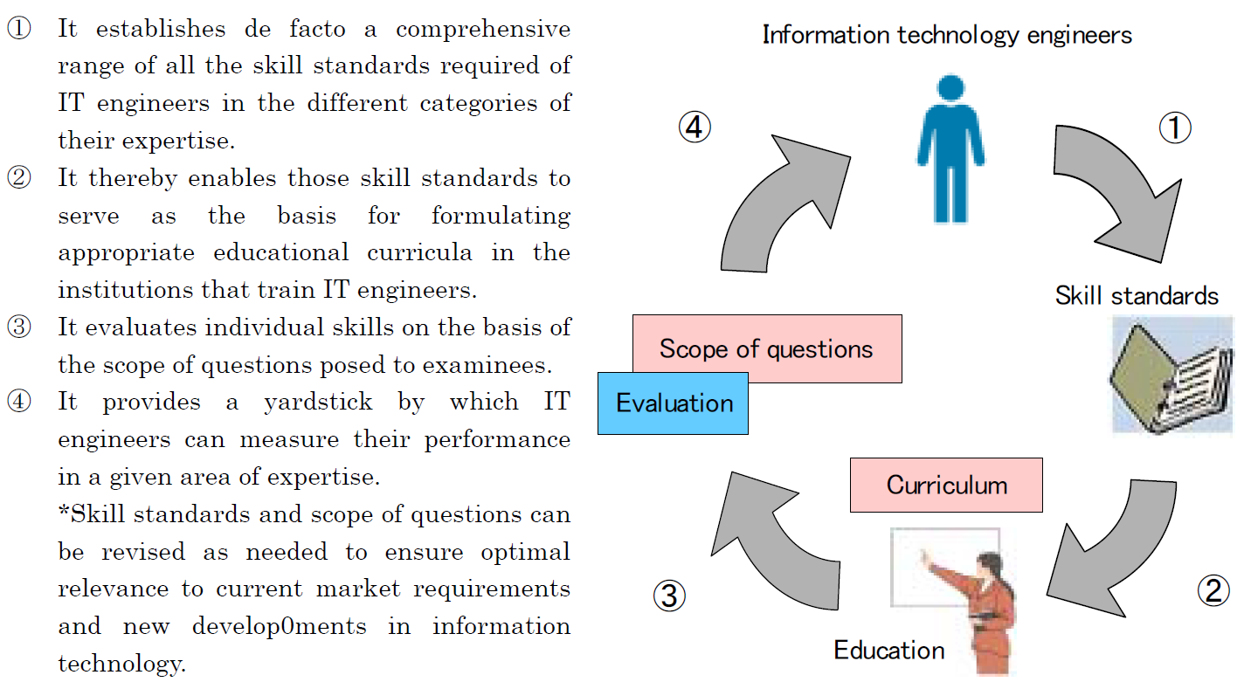
Education/Training/Evaluation Cycle
Syllabus

Slide 6
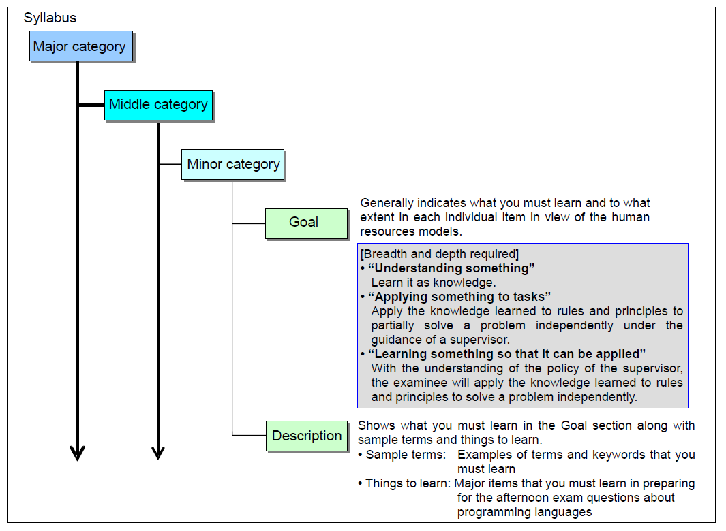
Configuration of the BoK & Syllabus
9
3
Skill Field
23
100

Slide 7
Examination Breadth and Depth

Slide 8
ITPE Project Management in Scope
Field | Major Categ |  | Middle Categ. |  | Minor Categ. |  | Examples of Knowledge Items
Management | 5 | Project management | 14 | Project management | 1 | Project management | project, project management, environment for project, project governance, project life cycle, project constraints, etc.
 |  |  |  |  | 2 | Project integration management | preparation of project charter, preparation of a project plan, direction of project activities, control of project activities, control of change, closing of project phase or project, collection of learned lessons, etc.
 |  |  |  |  | 3 | Project stakeholder management | identification of stakeholders, management of stakeholders, etc.
 |  |  |  |  | 4 | Project scope management | definition of scope, creation of WBS, definition of activities, control of scope, etc.
 |  |  |  |  | 5 | Project resources management | creation of project team, estimation of resources, determination of project organization, development of project team, control of resources, project team management, etc.
 |  |  |  |  | 6 | Project time management | activity sequencing, estimation of activity duration, development of schedule, control of schedule, etc.
 |  |  |  |  | 7 | Project cost management | estimation of cost, budget planning, control of cost, etc.
 |  |  |  |  | 8 | Project risk management | identification of risks, evaluation of risks, response to risks, control of risks
 |  |  |  |  | 9 | Project quality management | quality planning, execution of quality assurance, execution of quality control
 |  |  |  |  | 10 | Project procurement management | procurement planning, supplier selection, management of procurement, etc.
 |  |  |  |  | 11 | Project communications management | communications planning, distribution of information, management of communications, etc.

Slide 9
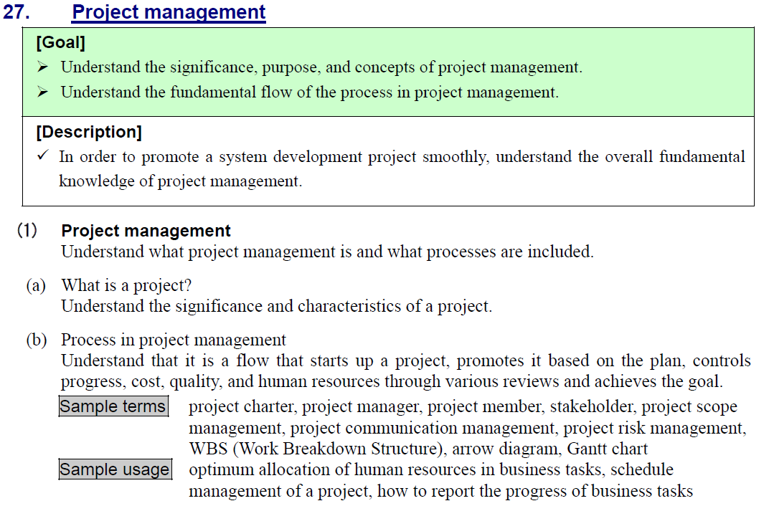
ITPE Level 1
Level1- IT Passport

Slide 10
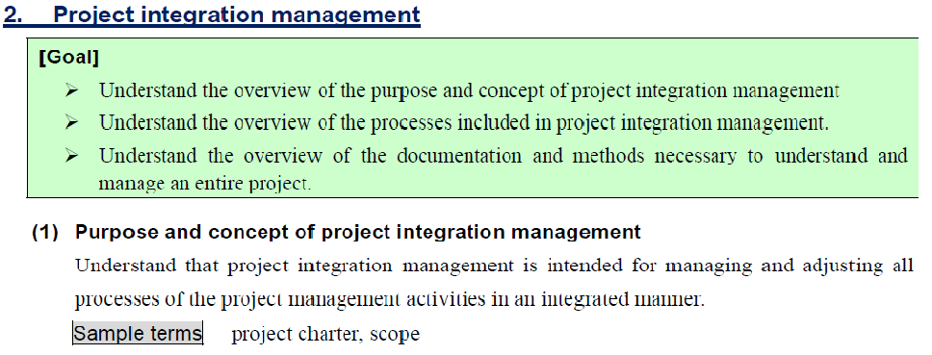
ITPE Level 2
Level2- Fundamental IT Engineer

Slide 11
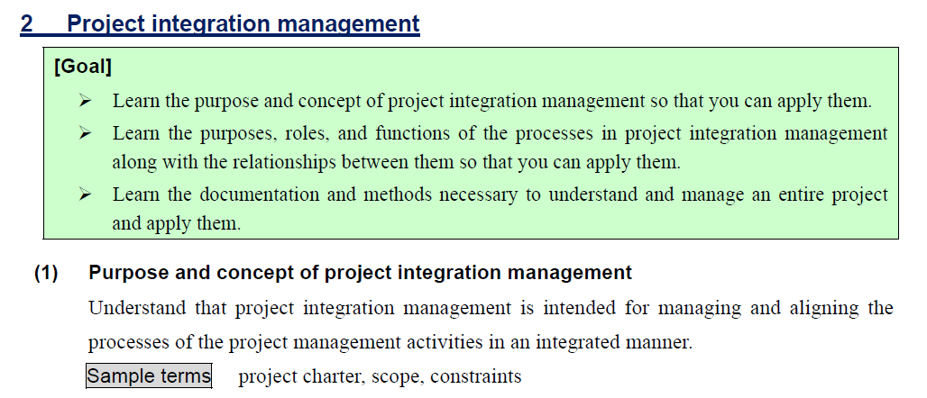
ITPE Level 3
Level3- Applied IT Engineer

Slide 12
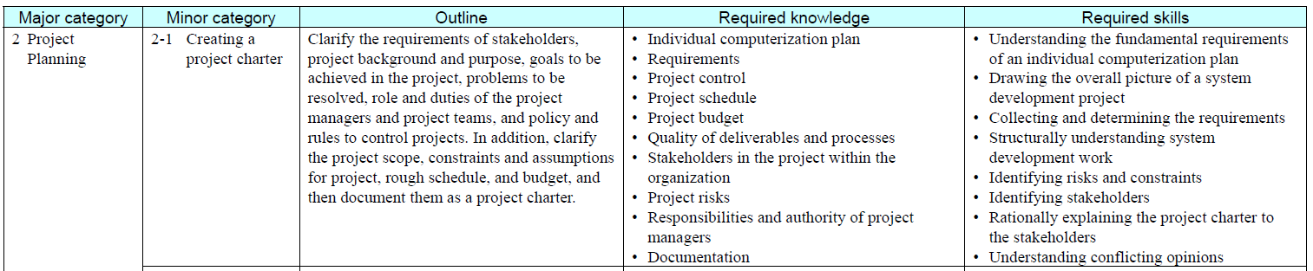
ITPE Level 4 - Project Manager
Level4- Project Manager

Slide 13
Training Roadmap

Slide 14
2. What is Training Roadmap?
Training Roadmap shows Required trainings to acquire skills by each fields/
each Job category.

Slide 15
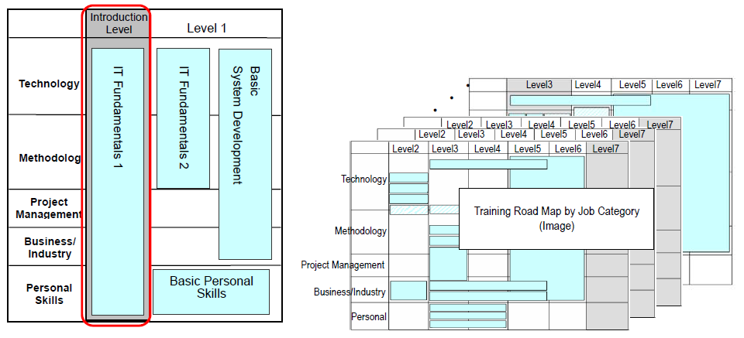
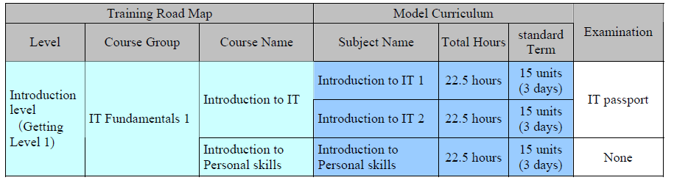
Relationship to Training Road Map
Each subject consists of 90 minutes x 15 units.
1 unit will be implemented in a week half a year to finish 1 subject

Slide 16
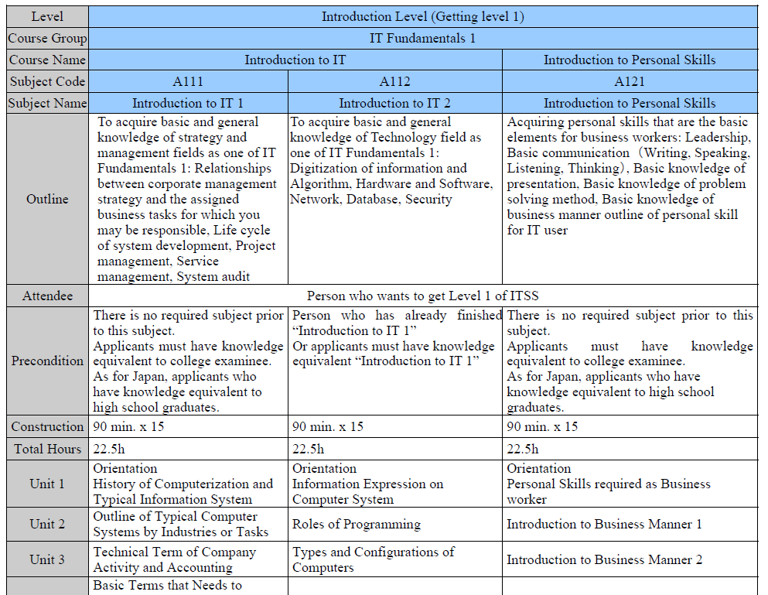
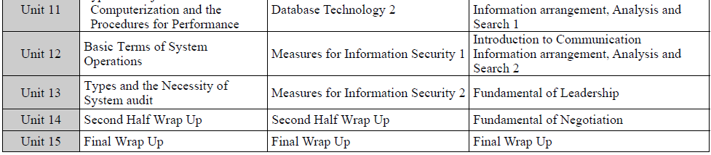
Model Curriculum

Slide 17
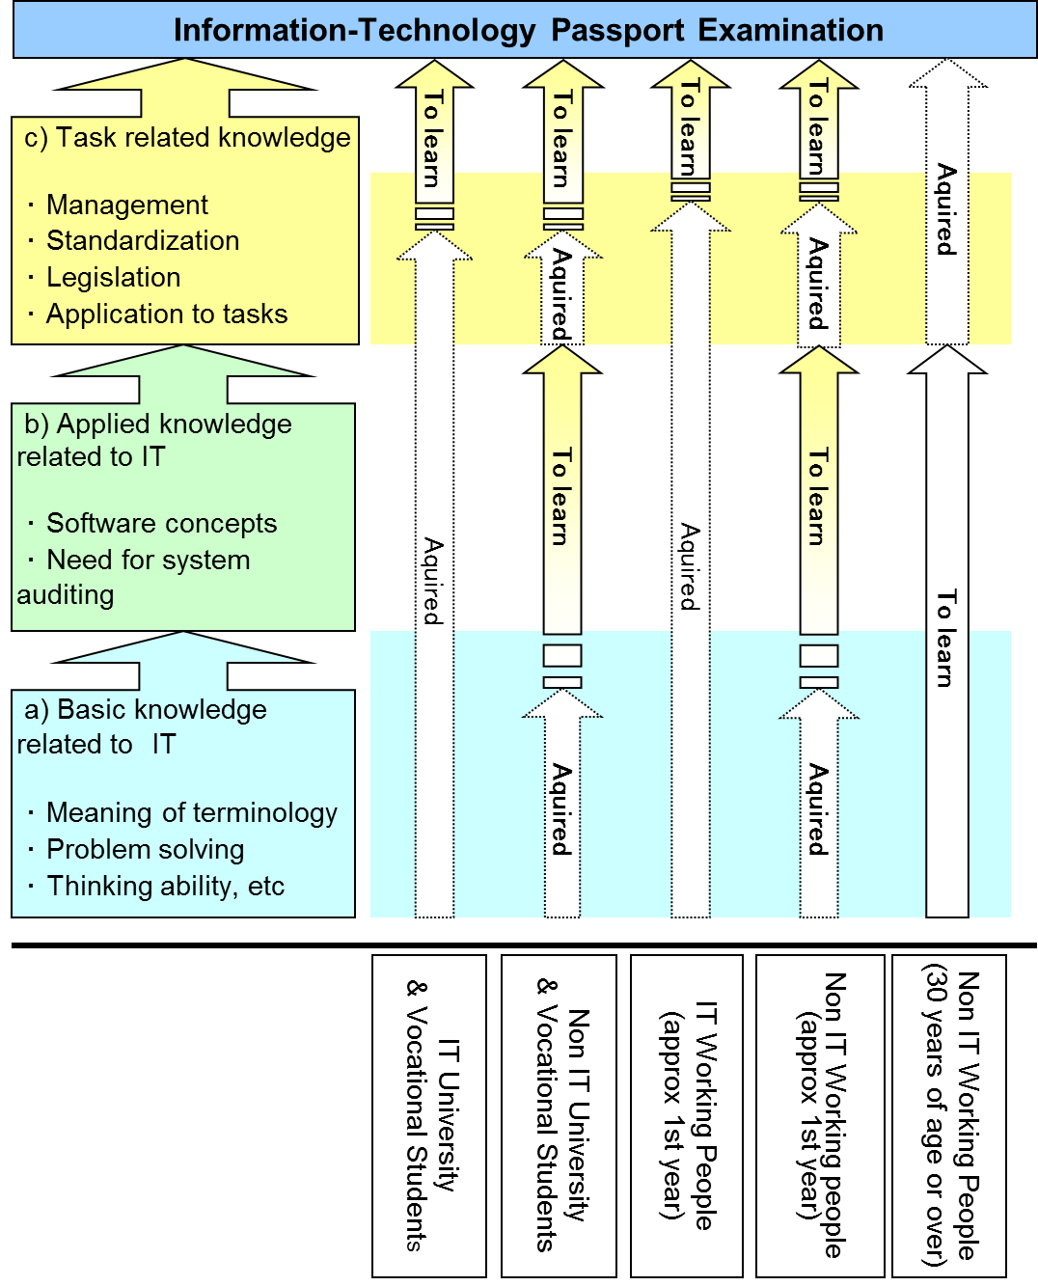

Slide 18
Concept of
Competency Development

Slide 19
What is Competency/competence?
Oxford:
The ability to do something successfully or efficiently
Wikipedia:
Competence is the ability of an individual to do a job properly.
Combination of practical and theoretical knowledge, cognitive skills, behavior and values used to improve performance
Competency might include systems thinking and emotional intelligence,
and soft skills in influence and negotiation.
Soft Skill: Communication, Language, Leadership, Facilitation
the cluster of personality traits, social graces, communication, language,
personal habits, interpersonal skills, managing people, leadership
vs
Hard Skill: generally easily quantifiable and measurable
software knowledge, basic plumbing skills

Slide 20
Competency Model
Evaluation thru Exams
(Hard Skill)
Evaluation thru Interview
(Soft Skill)

Slide 21

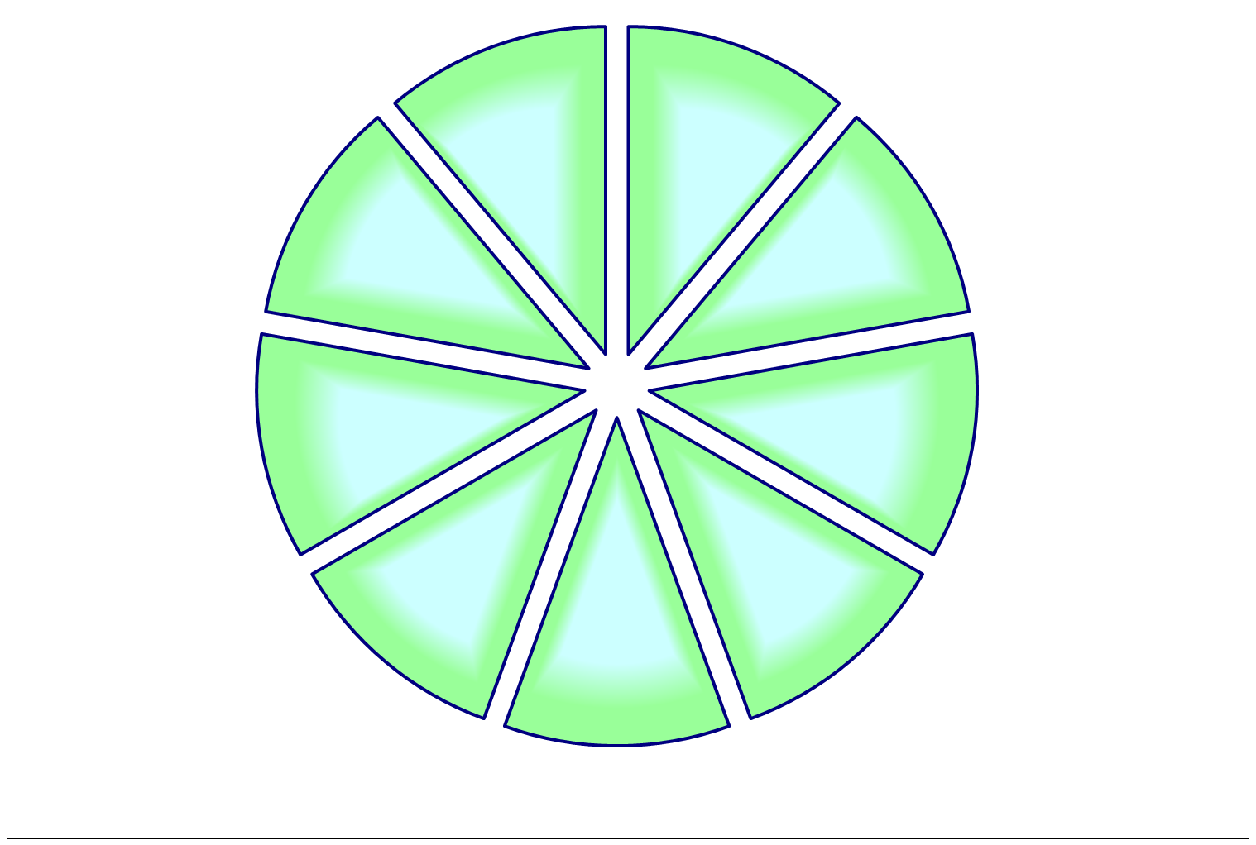
Foundational Competency
Passion for
the Business
Adaptability
Client Focus
Drive to Achieve
Taking Ownership
Core
Competency
Creative Problem Solving
Communication
Trustworthiness
Teamwork &
Collaboration
10
（ｃ）Copyright IBM Japan, Ltd. 2005 All rights reserved.
Notes:
リーダーシップ・コンピテンシー
勝利への集中
お客様に対する洞察力
創造的思考力
目標達成への推進力
実行への体制づくり
チーム・リーダーシップ
素直さ
チームワーク
決断力
勢いの持続
組織構築力
人材育成
全体への貢献
コアコンピテンシー
ビジネスへの情熱

Slide 22
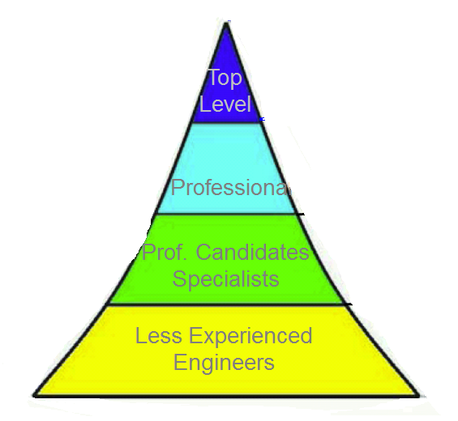
Objective of Human Resource Dev.
Competency
Level 7
Soft Skill
Hard Skill
Knowledge
Level 1

Slide 23
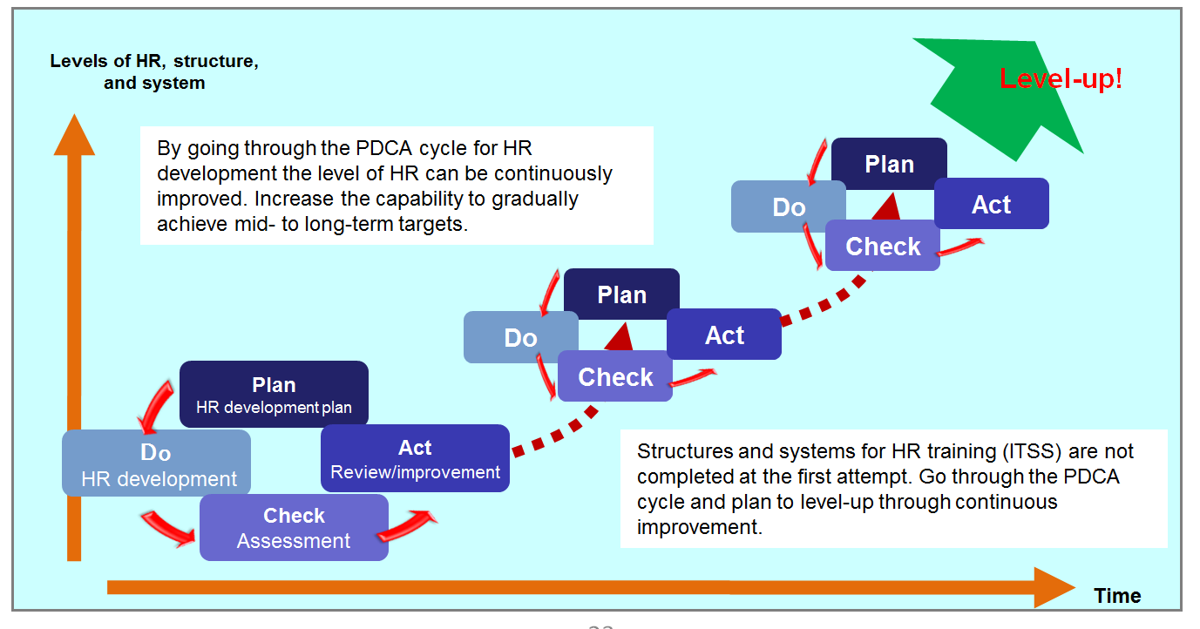
Concept of how to develop Knowledge, Skills, and Competencies using the PDCA cycle

Slide 24
Concept of Professional Evaluation Cycle
Level 5
3rd Step
Lead Project
Interview
Mentoring
Utilizing
Experiences
Competency
Firm up
Level 4
Project On-Site
2nd Step
Lead Projects
Professional Contribution
EXAM/
Interview
Utilizing
Experiences
Soft Skill
Firm up
Level 3
Project On-Site
Outside
Activities
1st Step
Experience
Skill Acquisition
IT Eng.
Exam.
Utilizing
Knowledge
Skill
Firm up
Level 2
Project On-Site
Training
Experience
Knowledge Acquisition
IT Eng.
Exam.
Utilizing
Knowledge
Knowledge
Firm up
Project On-Site
Education
Knowledge Acquisition
Real Project Fields
Study
Notes:
ＰＭ育成には次の４つの育成手段が体系的、有機的に活用されてはじめて効果が出てくる
1.知識を習得するための研修
2.経験を積む場としてのプロジェクトでの実践
3.習得した知識を実践の場で間違いなく発揮できる、また、より高い場へ引き上げるための指導者による指導や支援としてのメンタリングやコーチング
4.いろいろな経験や考え方の違うＰＭの方々との交流を深められ、自己成長が促進されるＰＭコミュニティへの参加
ＰＭの育成は、ＰＭになろうとしている人とその人が所属する組織・企業のＰＭ育成の仕組みとが有機的に調和し合って成し遂げられる。

Slide 25
Methods to promote Competencies, Skills and Knowledge
 | Characteristic
Coaching | helping another person to improve awareness, to set and achieve goals in order to improve a particular behavioral performance
Mentoring | helping to shape an individual’s beliefs and values in a positive way; often a longer term career relationship from someone who has ‘done it before’
Counseling | helping an individual to improve performance by resolving situations from the past.
Teaching | helping an individual or group develop cognitive skills and capabilities
Guiding | the process of directing an individual or a group along the path leading from present state to a desired state

Slide 26
Coaching or Mentoring
Both Coaching and Mentoring contribute to the overall purpose of helping engineers and professionals to be more productive and deliver more value to the organizations and individuals
Coaching | Mentoring
Offers advice and guidance as the latter learns; focusing on competence specifics, as opposed to general overall development. | enables an individual to follow in the path of an older and wiser colleague who can pass on knowledge, experience
Leverages on-the-job activities to challenge thinking in a defined focus behavior by a leader, peer, recognized expert, or trained professional | Relationship between more experienced and less experienced employees for networking, career guidance, or experiential advice
Focus on potential, soft-skills, personal development and self-awareness | Focus on performance, competencies and professional development
Coaches will ask 'powerful' questions and not offer or give advice.. | Mentors will often provide direction and advice and should 'open organizational doors' for mentees.
Effective coaching is intended to help you to learn rather than by “teaching” you. By engaging with an experienced coach, the coachee will develop insights leading to enhanced effectiveness. | Mentoring involves helping mentees to develop their career, skills and expertise often drawing upon the experiences of the mentor in the process.
Agenda is set by the coachee | Agenda is set by the mentor
Coach is not necessarily SME, while having credibility | Mentor is SME

Slide 27
TPQI and IPA Skill Definitions

Slide 28
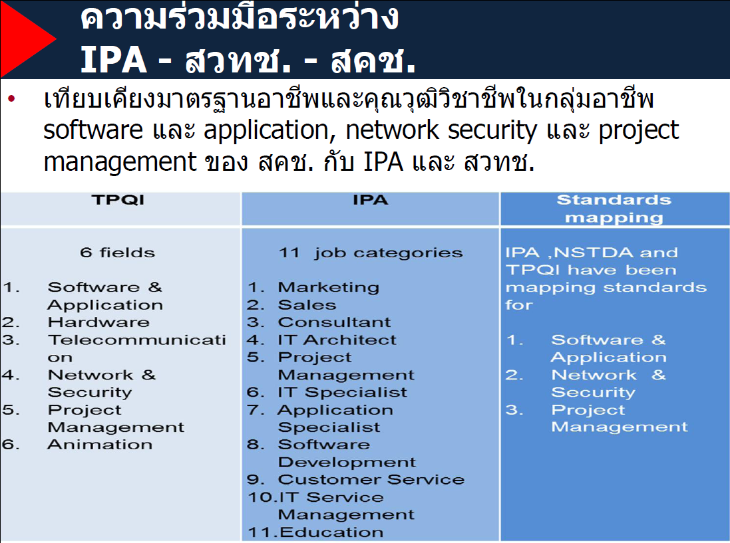

Slide 29
TPQI Competency & ITPE/ITSS
ITPE/ITSS
TPQI
Sales/
Marketing/
IT Service Management
Etc.
HW
SW & Application
Animation
PM
Telecom
NW & Security

Slide 30
TPQI Unit of Competence(60101)-1
1. UNIT CODE: 60101 2. UNIT NAME: Project Charter Development
3. REVIEW: - 4. CREATE NEW: 
5. Occupational Classification
Project Manager [ILO - 08 References: CODE 1330 ICT Services Managers]
6. Description of Unit of Competency
Generate project scope of work,
Identify and Analyze Business Case
Cerate Project Charter
7. Qualification Level
1 | 2 | 3 | 4 | 5 | 6 | 7
 |  |  |  |  |  | 
8. Occupational Sector
Information Communication Technology Domain
9. Occupation can Used this Unit
1120 Managing Directors and Chief Executives

Slide 31
TPQI Unit of Competence(60101)-2
10. Licensing or Regulation Related
Not Applicable
11. Elements and Performance Criteria
Element | Performance Criteria | Assessment
60101.01 Generate project scope of work | 1.1 Define business requirement base on all related factors 1.2 Set product and/or services property clearly | 1. structured interview or paper base test 2. leader observation forms
60101.02 Identify and Analyze Business Case | Analyze business case probability (Business Case) | 1. structured interview 2. paper base test
60101.03 Create Project Charter | Create Project Charter details covered | 1. structured interview 2. paper base test
12. Pre-requisite Skill & Knowledge
None

Slide 32
TPQI Unit of Competence(60101)-3
13. Required Skills and Knowledge
Must Have Skill
Must Have Knowledge
14. Evidence Guide
Performance Criteria
Required Skills and Knowledge
Performance Evidence
Knowledge Evidence
15. Range Statement
PMI หรือ ISO 21500
16. หน่วยสมรรถนะร่วม (If any)
None
17. อุตสาหกรรมร่วม/กลุ่มอาชีพร่วม (If any)
None
18. Assessment Description and Procedure
None

Slide 33
TPQI Unit of Competence(60101)-4
14. Evidence Guide
Performance Criteria
Required Skills and Knowledge
Performance Evidence
Knowledge Evidence
15. Range Statement
PMI หรือ ISO 21500
16. หน่วยสมรรถนะร่วม (ถ้ามี)
ไม่มี
17. อุตสาหกรรมร่วม/กลุ่มอาชีพร่วม (ถ้ามี)
ไม่มี
18. รายละเอียดกระบวนการและวิธีการประเมิน (Assessment Description and Procedure)
ไม่มี

Slide 34
TPQI Skill Area : Computer and Computer System Servicing
TPQI Practical Skill/Exam Area
Level 1-2
UoC *¹
EoC *²
UoC
EoC
EoC
EoC
EoC
・・・
EoC
EoC
UoC
・・・
EoC
UoC
EoC
EoC
・・・
EoC
EoC
*1 Unit of Competence(UoC)
*2 Element of Competence(EoC)
・IT Passport Skill area from syllabus of IT Passport
・Questions from IT Passport
Exemption of IT Passport Exam Passer

Slide 35


Broad Areas for Collaborations
Thailand Gov.
MOU
Using Each Party’s
Excellence
Experience
Existing Systems
Japanese
Gov.
Thailand
Gov.
For the next ICT Era
of
Thailand/Japanese Relationship

Slide 36
ASEAN ICT Master Plan 2015

Slide 37
ASEAN Connectivity Master Plan (15 prioritized projects)
1 | Physical Connectivity | Completion of the ASEAN Highway Network (AHN) and upgrade of Transit Transport Routes (TTRs)
2 |  | Completion of the Singapore Kunming Rail Link (SKRL)
3 |  | Establish an ASEAN Broadband Corridor (ABC)
4 |  | Melaka-Pekan Baru Interconnection (IMT-GT: Indonesia)
5 |  | West Kalimantan-Sarawak Interconnection (BIMP-EAGA: Indonesia)
6 |  | Study on the Roll-on/roll-off (RoRo) network and short-sea shipping
7 | Institutional Connectivity | Developing and operationalizing mutual recognition arrangements (MRAs) for prioritized and selected industries
8 |  | Establishing common rules for standards and conformity assessment procedures
9 |  | Operationalize all National Single Windows (NSWs) by 2012
10 |  | Options for a framework/modality towards the phased reduction and elimination of scheduled investment restrictions/impediments
11 |  | Operationalization of the ASEAN Agreements on transport facilitation
12 | People-to-People Connectivity | Easing visa requirements for ASEAN nationals
13 |  | Development of ASEAN Virtual Learning Resources Centres (AVLRC)
14 |  | Develop ICT skill standards
15 |  | ASEAN Community building programme
Source: Master Plan on ASEAN Connectivity

Slide 38
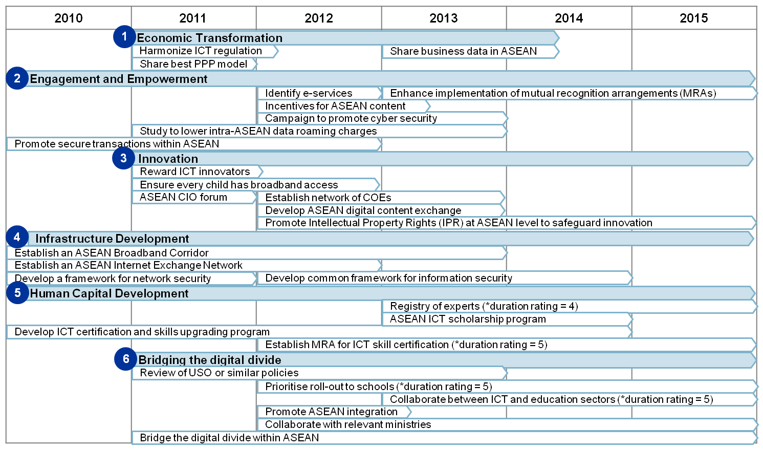
ASEAN ICT Master plan 2015 Timeline
Source: ASEAN ICT Master plan 2015

Slide 39
ITPEC Ambassordor

Slide 40











ITPEC Top Guns
Top gun among ITEE (FE or AP) passers
(2 from each country)
＋
1 person from ITPEC implementing bodies
Internship Program in Japan
For 10 Days

Slide 41
Top Gun Program Agenda
Date | Description
Feb 23 (Mon) | Program Orientation
 | Opening by IPA - Current situation of IT industry and ITPEC -
 | NTT Communications Corporation - Business overview - Presentation by Technology Development Department (1. Web Technology, 2. Data Scientist, 3. Security, 4. NW Core, 5. SDN)
Feb 24 (Tue) | NEC Solution Innovators, Ltd. - Business overview - Introduction of NEC's IT Technology
 | - Group discussion (5 minutes presentation by participants)
Feb 25 (Wed) | Project management seminar1 Mr. Hirotoshi Kanba, Mr. Hidetaka Nakajima PMI Japan Chapter
 | Project management seminar2
Feb 26 (Thu) | Project management seminar3
 | NTT Communications Corporation (Tokyo No.6 Data Center)
 | METI (Ministry of Economy, Trade and Industry)
 | NTT Hibiya Building (Kasumigaseki Cable Tunnel)
Feb 27 (Fri) | Presentation by participants (1.what you were interested in during the stay, 2. your findings/observation in the Japanese companies, 3. what you like to try after returning to your country as ITPEC Ambassador ) - Q & A
 | Closing ceremony Mr. Kazumasa Fujie Chairman, IPA

Slide 42
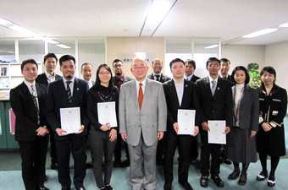
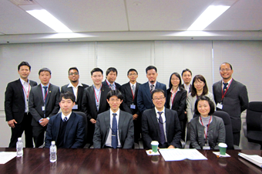
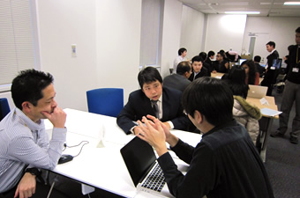

ITPEC Ambassadors
Next ITPEC Top Gun Program will be held in February 2016!

Slide 43
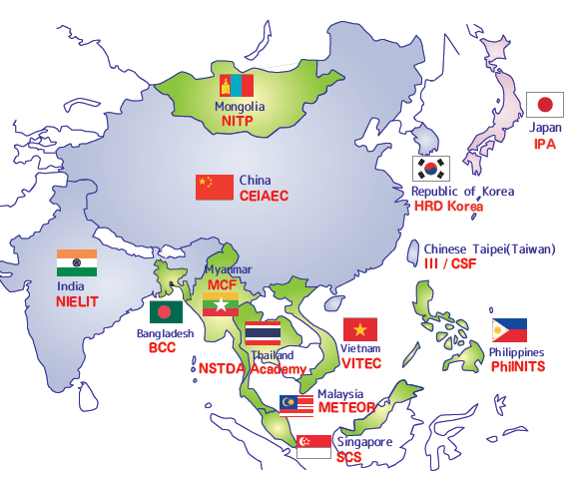
Mutual Recognition in Asia
Develop a competitive ICT workforce
Open borders to economic opportunities

Slide 44
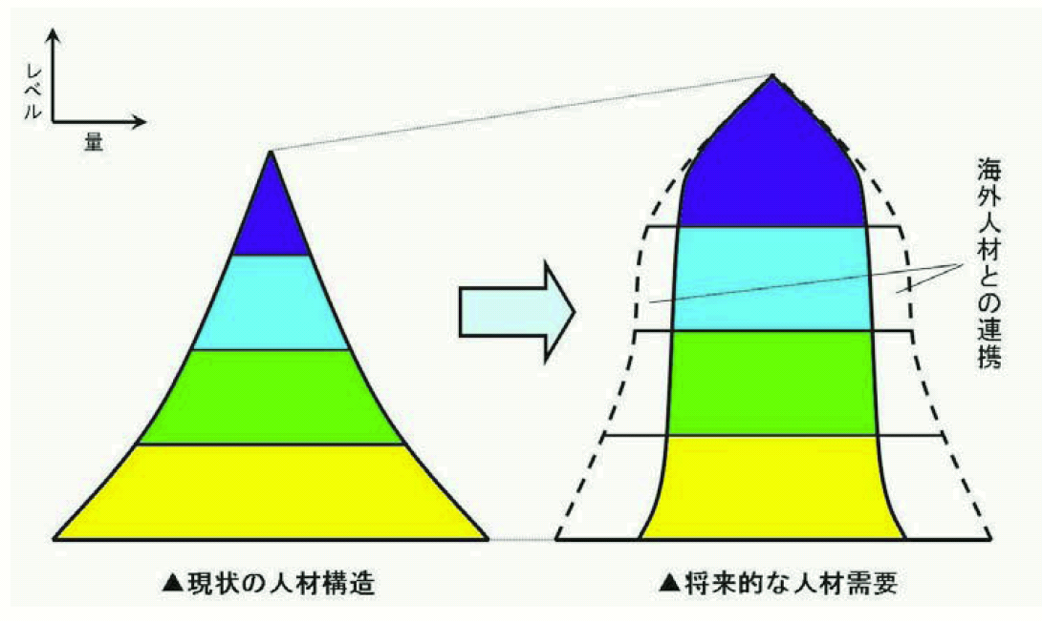
Distribution of ICT Human Resource
Level
Top
Level
HR with Asian Countries
Quantity
Top
Level
Professional
Professional
Prof. Candidate
Specialist
Prof. Candidates
Specialists
Less Experienced Engineers
Less Experienced Engineers
Current Status
Future Objective
高度情報通信人材育成の加速化に向けて
―ナショナルセンター構想の提案―
(社)日本経済団体連合会
Notes:
Federation of Economic Organizations
Concept chart of IT resource distribution.
Fujiyama
Cannon-shot
Bell Shape
Thicker middle class professional
Top level is much higher and thicker
Corporation of Asian Human resource to be Bell shape.

Slide 45
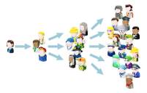


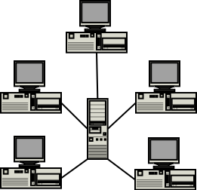




History of IT Industry
3rd Generation
HR Development
Web Based NW
2nd Generation
Dev. Process
IT Service
1st Generation
Quality Circle
Soft Ware
SNS
Network
Web/Internet
Cloud
Computing
Hard Ware
Client/Server
Stand Alone
Mini/Personal
Computer
Ubiquitous society
Main Frame
Google
Amazon
DEC
DG
Distributed Processing
Netscape
Microsoft
Face Book
LINE
IBM
UNIVAC
HP
DELL
Centralized Processing
～1970
1980
1990
2000
2010～
45
All Rights Reserved, Copyright© IPA 2011
Notes:
所有する形態から、利用する形態への変化
45

Slide 46




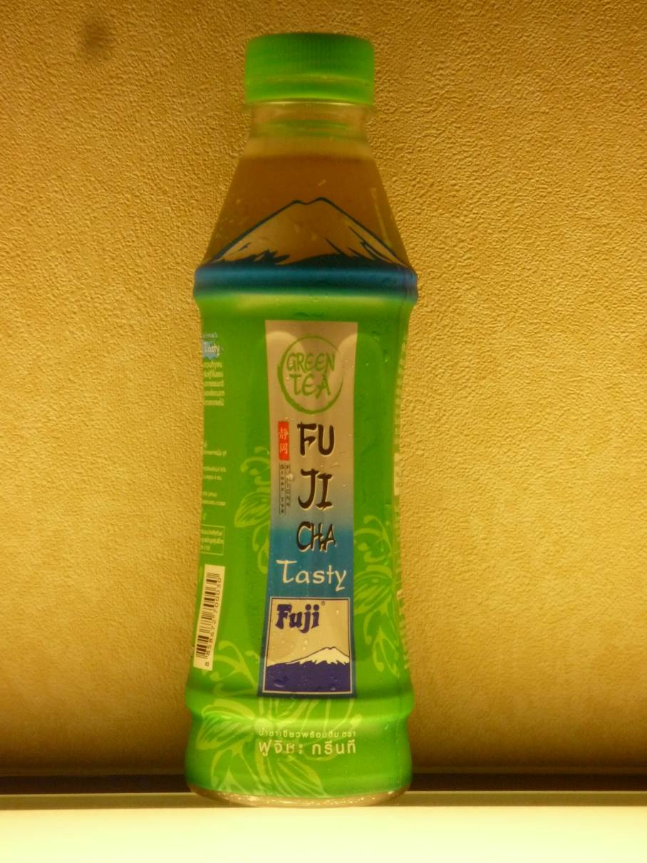


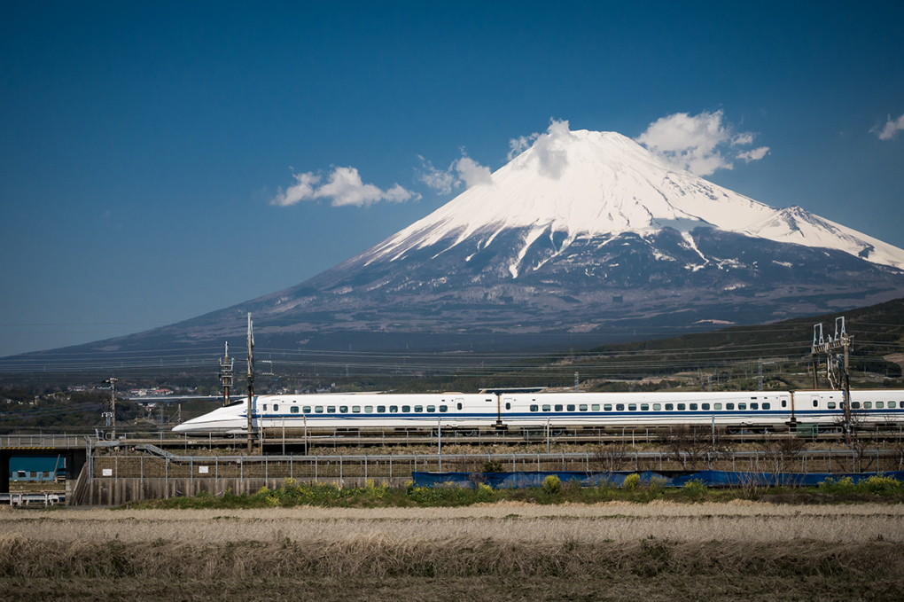


Slide 47
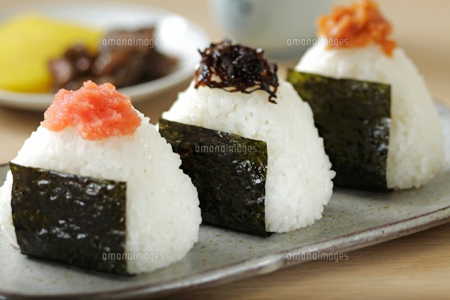
ICT technology like Steamed Rice(ONIGIRI) for Japanese?

Slide 48
Thank you!
IPA (Information-Technology Promotion Agency, Japan
IT Human Resource Development Headquarters
Center for Human Resources Development Initiative
ITPE(IT Professional Examination) by NSTDA
http://www.nstdaacademy.com/webnsa/index.php/sss
ITSS Documents(English Edition) Download URL:
http://www.ipa.go.jp/english/humandev/forth_download.html
48
48
Notes:
Confidential機密性2
機密性2

Slide 49
History of IT Industry
3rd Generation
HR Development
Web Based NW
2nd Generation
Dev. Process
IT Service
1st Generation
Quality Circle
Soft Ware
SNS
Network
Web/Internet
Cloud
Computing
Hard Ware
Client/Server
Stand Alone
Mini/Personal
Computer
Ubiquitous society
Main Frame
Google
Amazon
DEC
DG
Distributed Processing
Netscape
Microsoft
Face Book
LINE
IBM
UNIVAC
HP
DELL
Centralized Processing
～1970
1980
1990
2000
2010～
49
All Rights Reserved, Copyright© IPA 2011
Notes:
所有する形態から、利用する形態への変化
49

Slide 50

Broad Areas for Collaborations in Thailand
Qualifications
Examinations
IT Skill Standards
Toward the AEC 2015

Slide 51
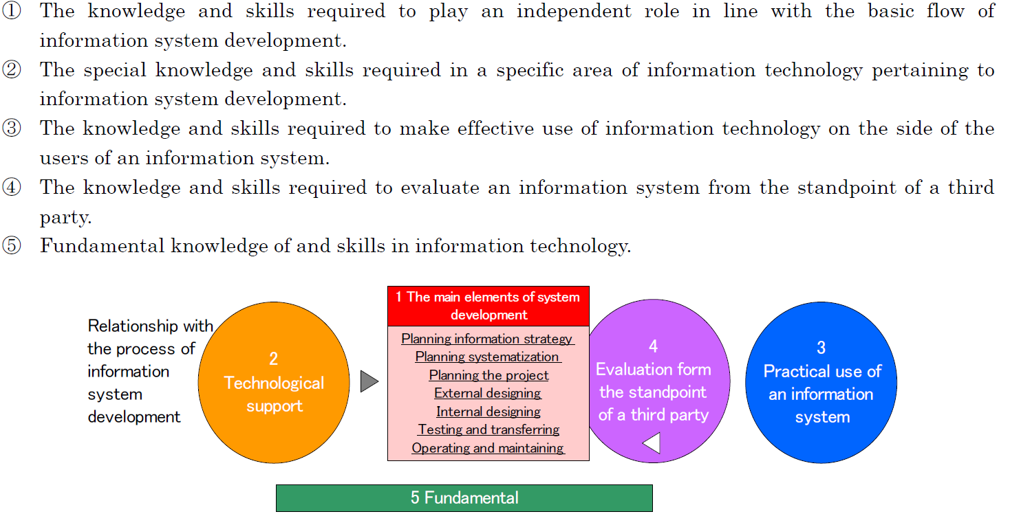

Slide 52
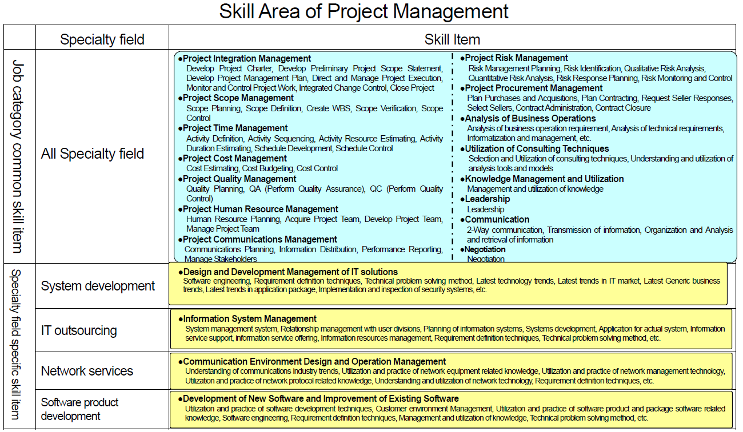
ITSS

Slide 53
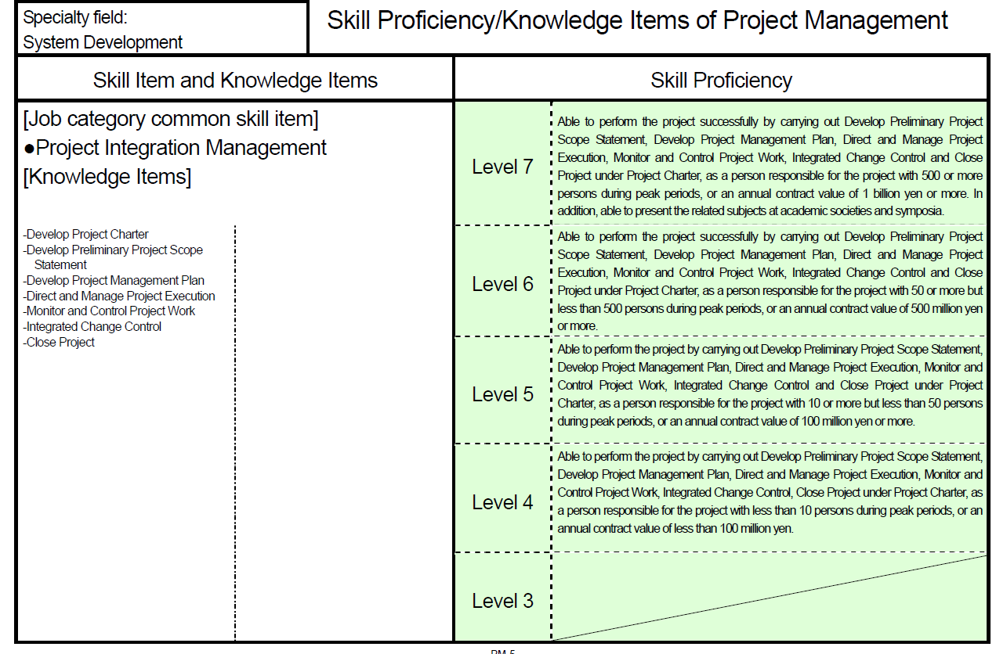
ITSS

Slide 54
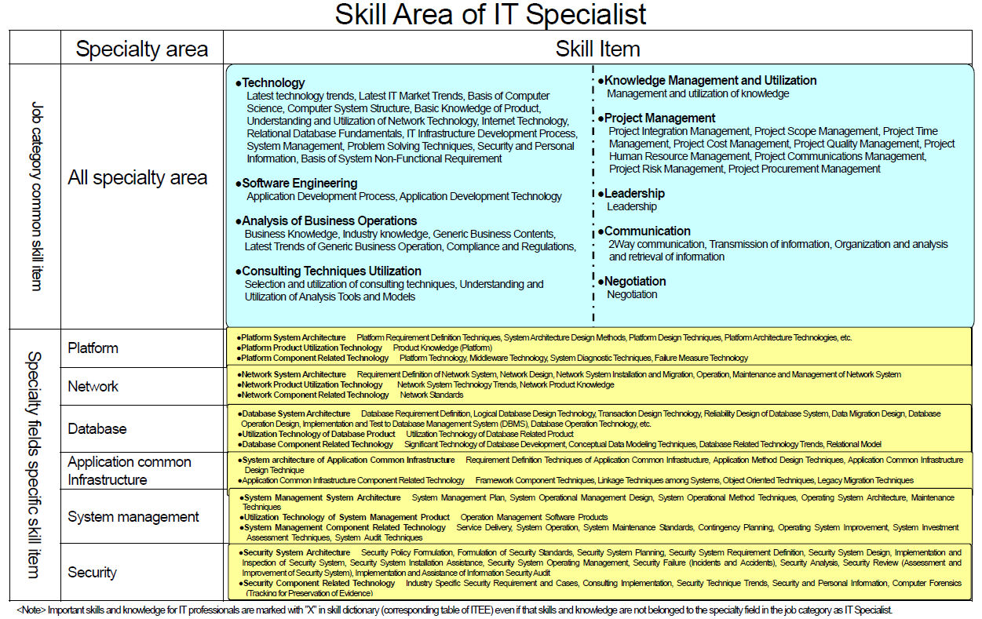
ITSS - DB

Slide 55
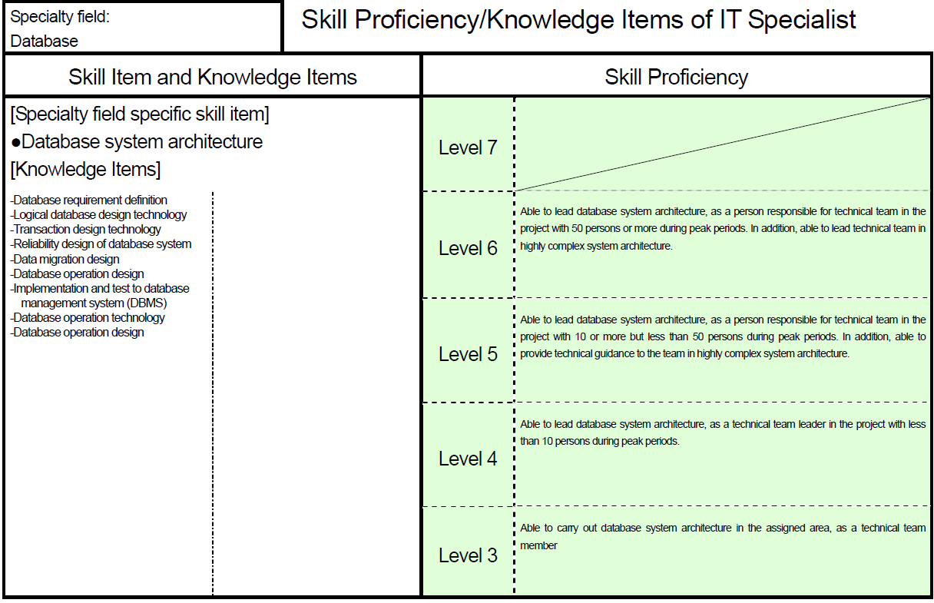
ITSS - DB

Slide 56
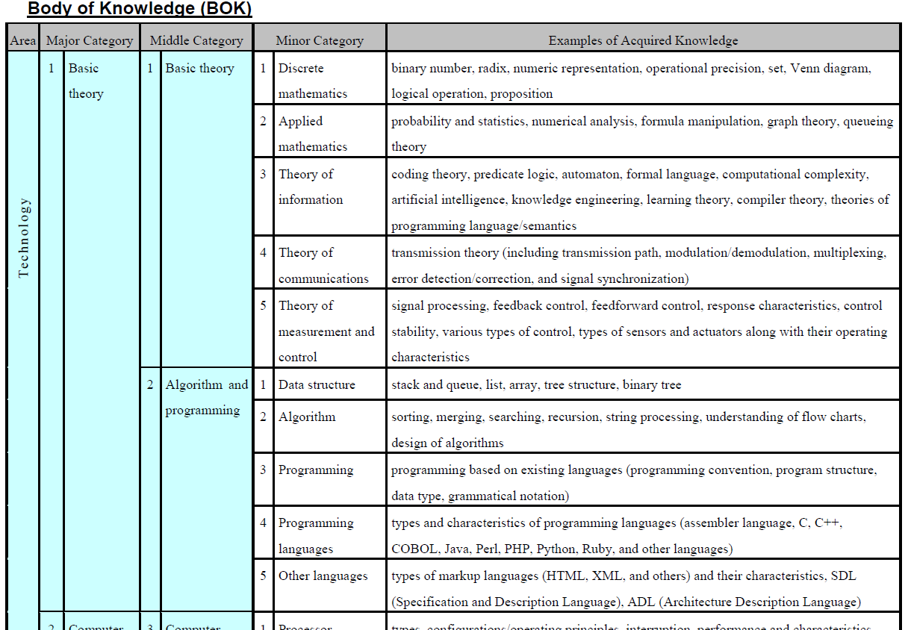
Body Of Knowledge

Slide 57
Syllabus

Slide 58
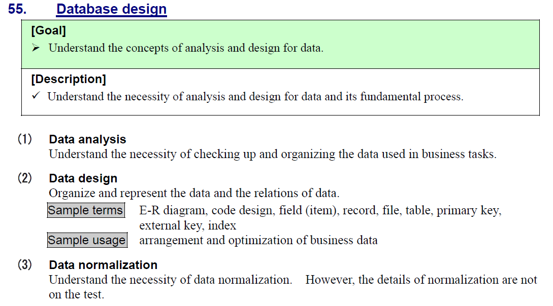
ITPE Level 1
Level1- IT Passport

Slide 59
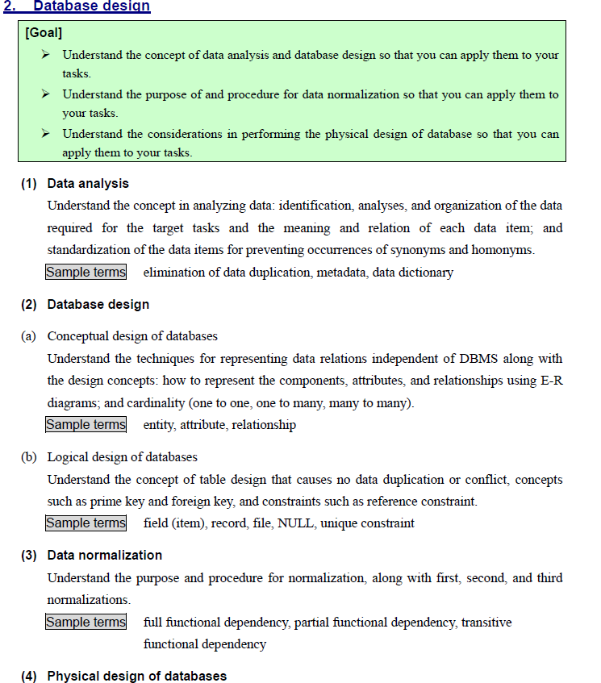
ITPE Level 2
Level2- Fundamental IT Engineer

Slide 60
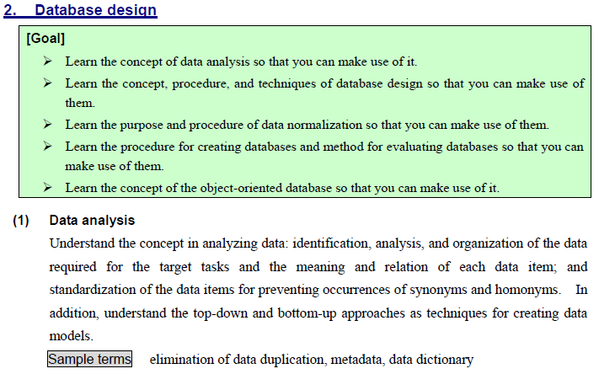
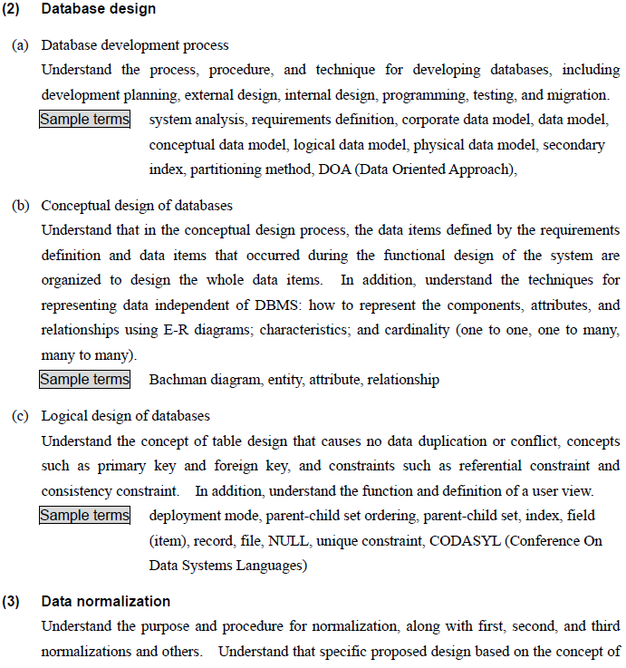
ITPE Level 3
Level3- Applied IT Engineer

Slide 61
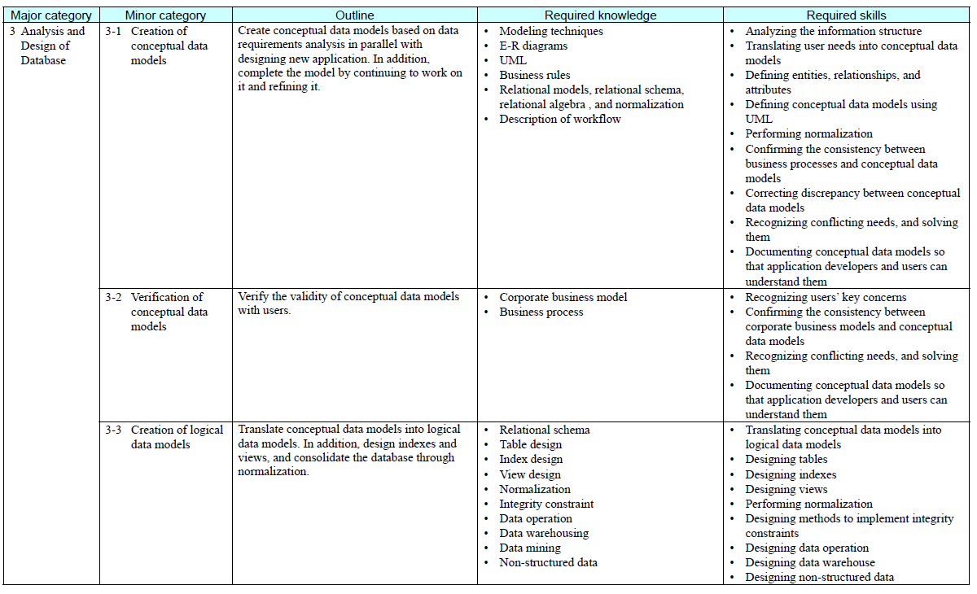
ITPE Level 4 - DB

Slide 62
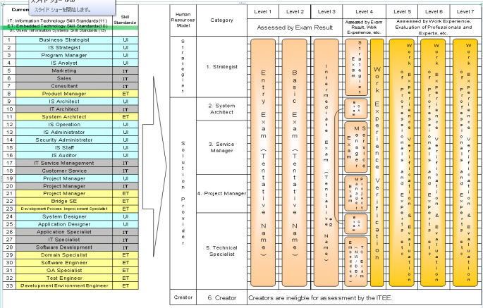
Common Career and Skill Framework as a reference model in Japan
Information
Technology
Engineers Exam.
(ITEE)
Skill Standards
for IT Professionals
（ＩＴＳＳ）
Conform
Body of Knowledge
Users' Information
Systems
Skill Standards
（ＵＩＳＳ）
Embedded
Technology
Skill Standards
（ＥＴＳＳ）

Slide 63


