Slide 1

TPQI Workshop 2015
Keynote
June, 2015
Ogawa, Kenji
VP of IT Human Resource Development HQ
Information-technology Promotion Agency, Japan
http://www.ipa.go.jp/index-e.html
Notes:
お早うございます。
タガログ
マヨン ハガ
こんにちは
タガログ
マガンダ（ング） ハポン ング←小文字
セブアノ、ビサヤ
マヨン ハポン
私は小川です。
アコ シイ オガワ アイシイ←小文字
どうもありがとう
タガログ
マラーミン（グ） サラマポウ
セブアノ、ビサヤ
サラマット カーヨ
小川
タガログ
イーログ ilog（？）
セブアノ、ビサヤ
サパ（↓）

Slide 2
Introduction
Information-technology Promotion Agency(IPA)
IPA is
an Independent Administrative Agency, sponsored by Ministry of Economy, Trade and Industry (METI).
Our role is
METI makes IT policies
IPA realize their IT Policies
  Solve diverse IT issues
  Create an IT-based society
Contribute to achieve Safe, Secure, and Reliable IT Society

Slide 3

Mission of IT HR Development HQ
Implementation
of
IT Engineers
Examination
(ITEE)
Strengthen
collaboration
with
Asian countries
Operation of
Skill Standards for
IT Professionals
(ITSS)
Exploratory
IT Human
Resource Project
(the MITOH
program)
Advance IT for
SMEs and
local
communities
Notes:
１．ITスキル標準の運用
高度IT人材像の明確化と客観的な評価メカニズムの提供
２．情報処理技術者試験の実施
国家試験としての情報処理技術者試験の実施
３．未踏人材発掘育成
突出した逸材「スーパークリエーター」の発掘
次世代の日本のIT産業界を担うグローバルに通用する人材の育成
４．中小企業と地域のIT化推進
中小・中堅企業のIT化支援
地域におけるIT人材の育成を通してIT化に遅れる知己が出ないように支援
５．アジア各国との連携強化
ソフトウェア技術および市場のグローバル化に伴う国境を越えたIT人材の育成と確保
産学連携の推進
産業界で即戦力として通用するIT人材の育成

Slide 4
Concept of IT Human Resource Development

Slide 5
Japanese Industry Needs High Competence ICT professionals
HR development
problems faced
by companies
Factor caused
by change in business environment
Severe
shortage of
skilled
IT Professionals
Difficulty
in identifying
and training
Human Resources
Shift from
“Product”
to
“Services”
Increase of
Offshore
Development
(China, India etc.)
Diversified needs in IT service industry
Greater specialization in skills
Definition and Promotion of Skill Standards
Skill standards as common criteria for IT related industry
Notes:
企業が抱える人材育成の問題点
高度なIT人材が圧倒的に不足
必要なスキルを持った人材の把握・育成が困難
（パートナーを含めたIT人材のレベルの評価が困難）
（プロフェッショナルの育成市場・手段が貧弱）
（スキル保有度合いを評価する基準が不明確）
環境の変化が及ぼす要因
「モノ売り」の時代から「サービス」の時代へ
オフショア調達の進展
情報サービス産業における顧客のニーズの多様化
必要スキルもそれぞれのニーズに対応するために専門家・深化
IT人材に求められる実務能力を体系化した基準
「スキル標準」の策定・普及が必要
ITサービスの提供に必要な実務能力を体系化した「スキル標準」の普及
個々の人材を育成し、管理していくスキームが企業の競争力に直結

Slide 6
What is Competency/competence?
Oxford:
The ability to do something successfully or efficiently
Wikipedia:
Competence is the ability of an individual to do a job properly.
Combination of practical and theoretical knowledge, cognitive skills, behavior and values used to improve performance
Competency might include Hard Skill and Emotional Intelligence,
and Soft Skills in influence and negotiation.
Hard Skill: generally easily quantifiable and measurable
software knowledge, basic plumbing skills
vs
Soft Skill: Communication, Language, Leadership, Facilitation
the cluster of personality traits, social graces, communication, language,
personal habits, interpersonal skills, managing people, leadership

Slide 7
Competency Model
Evaluation thru Exams
(Hard Skill)
Evaluation thru Interview
(Soft Skill)

Slide 8
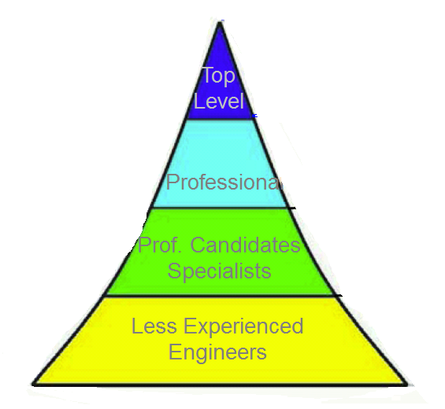
Objective of Human Resource Dev.
Level 7
Competency
Soft Skill
Hard Skill
Knowledge
Level 1

Slide 9
Concept of Professional Evaluation Cycle
Level 5
3rd Step
Lead Project
Interview
Mentoring
Utilizing
Experiences
Competency
Firm up
Level 4
Project On-Site
2nd Step
Lead Projects
Professional Contribution
EXAM/
Interview
Utilizing
Experiences
Soft Skill
Firm up
Level 3
Project On-Site
Outside
Activities
1st Step
Experience
Skill Acquisition
IT Prof.
Exam.
Utilizing
Knowledge
Skill
Firm up
Level 2
Project On-Site
Training
Experience
Knowledge Acquisition
IT Prof.
Exam.
Utilizing
Knowledge
Knowledge
Firm up
Project On-Site
Education
Knowledge Acquisition
Real Project Fields
Study
Notes:
ＰＭ育成には次の４つの育成手段が体系的、有機的に活用されてはじめて効果が出てくる
1.知識を習得するための研修
2.経験を積む場としてのプロジェクトでの実践
3.習得した知識を実践の場で間違いなく発揮できる、また、より高い場へ引き上げるための指導者による指導や支援としてのメンタリングやコーチング
4.いろいろな経験や考え方の違うＰＭの方々との交流を深められ、自己成長が促進されるＰＭコミュニティへの参加
ＰＭの育成は、ＰＭになろうとしている人とその人が所属する組織・企業のＰＭ育成の仕組みとが有機的に調和し合って成し遂げられる。

Slide 10
Use Examinations as a level evaluation tool.
ITSS
Level
Basic concept for assessment
Consideration
Examination
Level
Experience
and
performance
Skills and
knowledge
Effective
Use of ITPE
Simplified
assessment
Users’
convenience
Level 5 and more
Experience and performance
≒Competency
Level 4
High-level Exam. & work experience
Level 3
Passing of AP
in ITEE
Level 2
Passing of FE
in ITEE
Level 1
Passing of IP
In ITEE
Notes:
10
ITSS is based on the learning through experience. It encourages to acquire fundamental knowledge in lower levels.
・ITEE as effective assessment tools. User’s convenience and simplified assessment.
・Individuals are regarded as attaining the level 1,2 and 3 of ITSS, by passing ITEE in relevant levels.
・High-level Examinations are available for skill proficiency assessment in level 4
レベル１は、指導を受けて業務を遂行するレベル
レベル２は、一部の業務は独力で遂行できるレベル
レベル３は、担当業務はすべて独力でできるレベル
レベル４は、プロフェッショナルとして業務を遂行でき、後進の指導もできるレベル
としています。
レベル１～３は試験を活用して評価して行きましょうということです。
レベル４は、試験に加え、業務経歴などで経験と実績を併せて評価していきましょうということです。
-------------------------------------------------------------------------------------
良く質問されることとして、新試験と旧試験の対応についてどうなのかということを聞かれるのですが、新旧試験の対応そのものは、先ほど試験センターからご説明がありましたので省略いたしますが、ITスキル標準としては旧試験の合格をもってレベルを認めるのかということについては、基本的には、いいのではないかと考えております。
ただ、１０年、２０年前に一種に合格していて、対比表があるからといった話になりますと、それを評価に使うかどうかは、各企業の判断でやっていただきくしか無いと思います。 （スクリーン次へ）
-------------------------------------------------------------------------------------

Slide 11
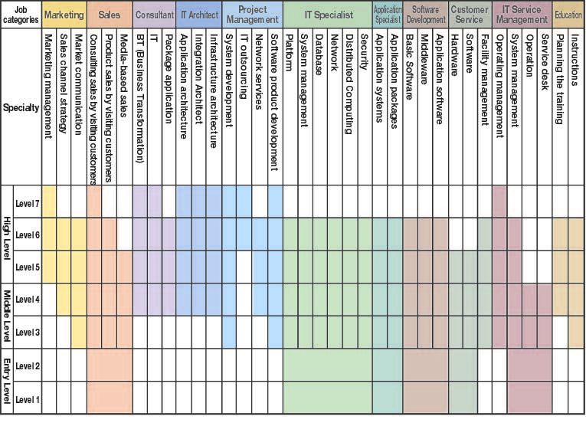
IT HR Development with NSTDA Exam.
ITSS
Examinations
ITEE
Management
Strategy
Technology
・・
・・・
・・
・・・
IT Industry
Team Building
Business Analysis
Management
Strategy
Certifications
Technology
Logical Thinking
・・・
Knowledge
・・

Slide 12
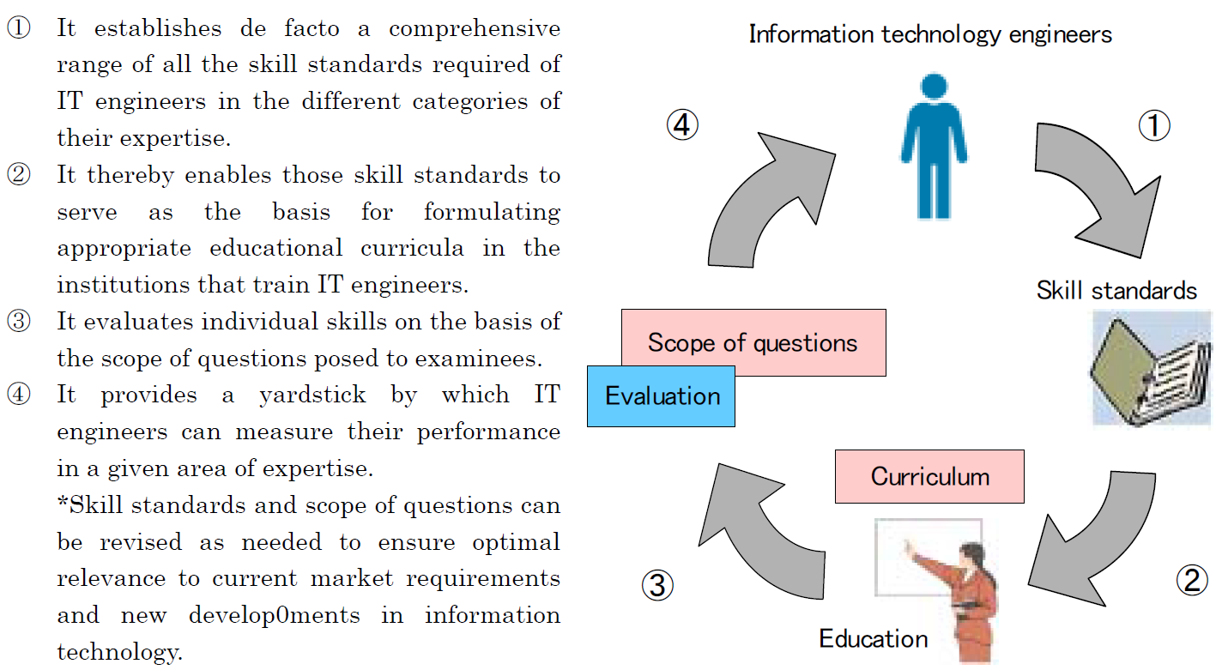
Education/Training/Evaluation Cycle
Syllabus

Slide 13
Introduce of new IT Passport Exam
LEVEL4
LEVEL4
LEVEL3
LEVEL3
Applied Information Technology Engineer Examination
LEVEL2
LEVEL2
Fundamental Information Technology Engineer Examination (FE)
Fundamental Information Technology Engineer Examination (FE)
LEVEL1
Information Technology Passport Examination (IP)
LEVEL1
Information Technology Passport Examination (IP)

Slide 14
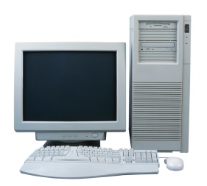
Largest National Examination in Japan by Act
When started?
1969
2 Exam categories 42,000 examinees
ITEE was launched in 1969
Concern from the industry fearing shortage of skilled IT engineers.
Voices from IT engineers seeking recognition of their knowledge and skills.
Heavy industries
IT industries
2015
12 Exam categories 400,000 applicants/year

Slide 15

IT Professionals
Examination Council
ITPEC: IT Professionals Examination Council
Formed to coordinate the exams using the same questions, on the same time, same date, starting April 2006
Current Members:
  Philippines, Thailand, Vietnam, Myanmar, Malaysia and Mongolia, Bangladesh.
Total No of Applicants of ITPEC Examination till Oct./2014 : 47,991

Slide 16










Japan invites ITPEC Top Guns as Ambassadors
Top gun among ITEE (FE or AP) passers
(2 from each country)
Internship Program in Japan
For 10 Days

Slide 17
Mutual Certification & MOU other than ITPEC
 | Examination Agency | Examination Category
 |  | PM | AE SA | NW | DB | SW AP | FE | AD IP | SU SC
India* | NIELIT |  | C Level |  |  | B Level | A Level
Singapore* | Singapore Computer Society (SCS) | CITPM
Korea* | Human Resources Development Service of Korea (HRD Korea) |  |  |  |  | Information Processing Engineer | Information Processing Industrial Engineer | Information Instrument Operation Craftsman
China* | Electronic Education & Examination Center (CEIAEC) |  | System Analyst | NW Engineer | DB System Engineer | Software Development Engineer | Programmer
Chinese Taipei** (Taiwan) | Institute for Information Industry(III) / Computer Skills Foundation (CSF) |  |  | Network Communication |  | Software Design and Development |  |  | System Analyst
*:Mutual Certification
**: Memorandum of Understanding

Slide 18
  Preferential Immigration Treatment into Japan
Mongolia (Aug. 2007)
（NITP)
Korea (Dec. 2001)
（HRD Korea ）
China (Jan. 2002)
（EIEC ）
India (Feb. 2001)
（NIELIT)
Chinese Taipei (Dec. 2003)
（III & CSF ）
Myanmar（Nov. 2002）
(MCF)
Vietnam（Jul. 2002）
(VITEC)
Thailand （Jun. 2002)
（NECTEC)
Philippines （Apr. 2002）
（PhilNITS Foundation)
Malaysia (Jan 2005)
(METEOR)
Bangladesh
(New Candidate)
Singapore（Aug 2001）
（SCS）

Slide 19
TPQI Skill Area : Computer and Computer System Servicing
TPQI Practical Skill/Exam Area
Level 1-2
UoC *¹
EoC *²
UoC
EoC
EoC
EoC
EoC
・・・
EoC
EoC
UoC
・・・
EoC
UoC
EoC
EoC
・・・
EoC
EoC
*1 Unit of Competence(UoC)
*2 Element of Competence(EoC)
・IT Passport Skill area from syllabus of IT Passport
・Questions from IT Passport
Exemption of IT Passport Exam Passer

Slide 20


Broad Areas for Collaborations
Thailand Gov.
MOU
Using Each Party’s
Excellence
Experience
Existing Systems
Japanese
Gov.
Thailand
Gov.
For the next ICT Era
of
Thailand/Japanese Relationship

Slide 21
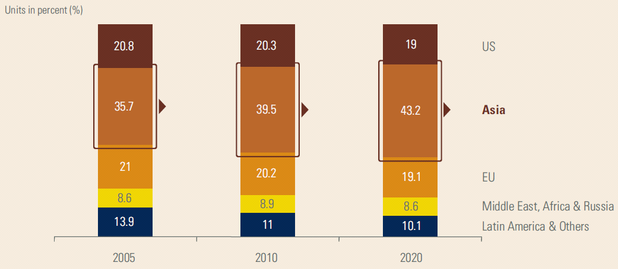
Asia’s Share in World GDP
Sources: EIU Foresight 2020 Report, KPMG Analysis
Asia-Oceania Vision 2020 ASOCIO Report
ASOCIO:Asian-Oceanian Computing Industry Organization

Slide 22
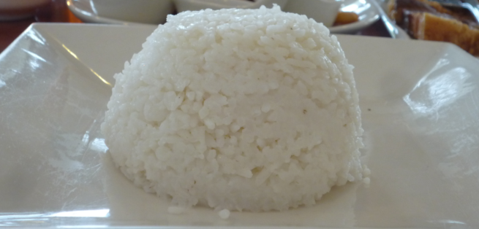
ICT technology like Steamed Rice for Thais?

Slide 23
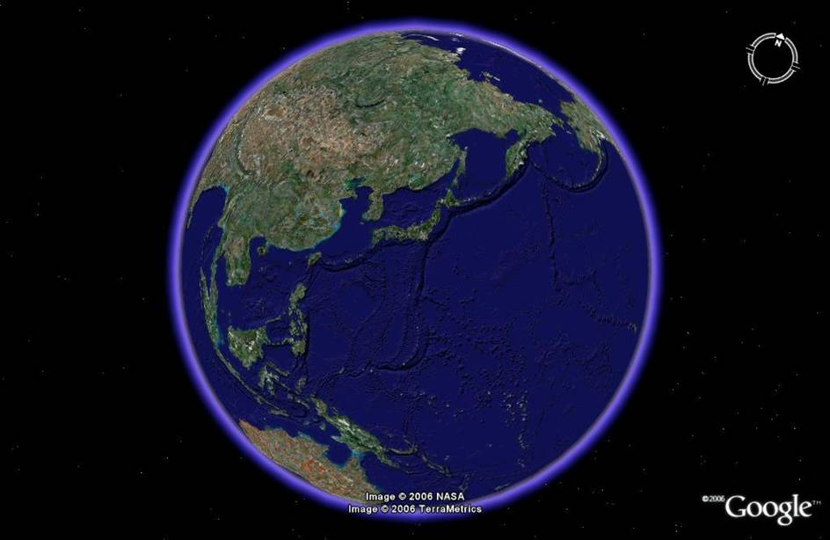
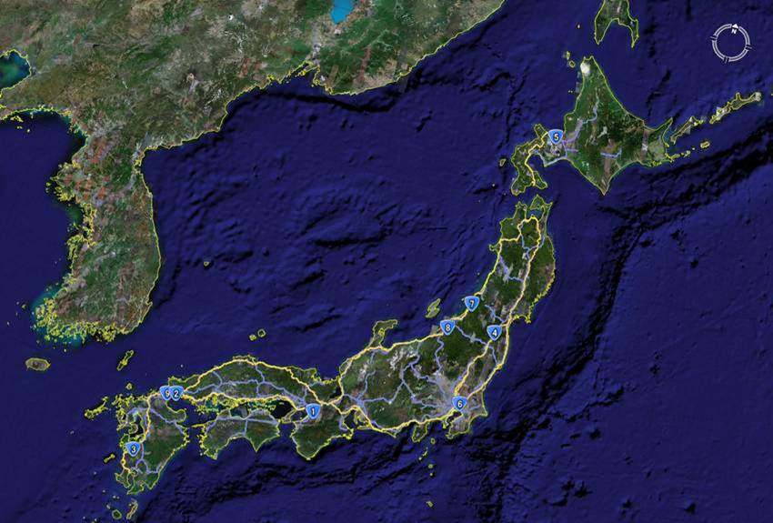
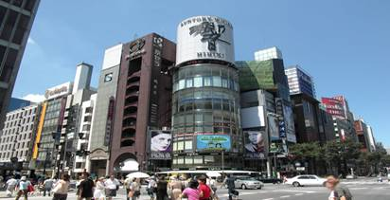



IT in the current/near future
Global Level
Internet
Air Traffic Control System
Vessel Management System
Intranet Computer NW
Global Financial System
International Tel & Telecom NW
National Level
National Defense System
Communication Satellite
Earth Observatory Satellite
Fixed-Line
Phone NW
Traffic Control system
Climate Satellite
Mobile Phone NW
Broadcasting Satellite
Railway
Control
Physical Distribution Management
TV-Radio Broadcasting NW
GPS,
Navigation Satellite
Postal Mail System
Geodetic Satellite
Weather Forecast System
Electricity, Gas, Water Service System
Military
Satellite
Earthquake Prediction
System
Town
ATM
Automatic Selling Machine
Wireless LAN
Crime-Prevention System
Fire Alarm System
Intelligent Transportation System
Car/ Embedded
Car Navigation
Meter/Warning System
Engine Ignition Control System
ABS
Air Conditioner
Railway
Road Traffic
Personal Life
Train Traffic Control
System
Reservation System
Automatic Ticket
Gate
Destination Sign
Board
Watch
Rechargeable IC Card
IC Credit Card
IC Cash Card
Digital Camera
Mobile Phone
Signal
Traffic Jam Information System
Cab Service System
Mobile Phone
Portable Music Player
Potable Game Machine
Note PC
PDA
23
All Rights Reserved, Copyright© IPA 2011
Notes:
23

Slide 24






Slide 25
Thank you
ITPEC (IT Professionals Examination Council)
http://www.itpec.org/
ITEE in Asia
http://www.ipa.go.jp/english/humandev/mutualrecognition.html

